Slide 1




Universitat Oberta
de Catalunya
uoc.edu
IMPACT OF 5-FU TREATMENT ON TUMOR CELL PLASTICITY IN COLORECTAL CANCER
Tutor/a de TFM: Laia Bassaganyas Bars
Professor/a responsable de l’assignatura: David Merino Arranz
Autor/a: Miquel Gratacós i Aurich

Slide 2
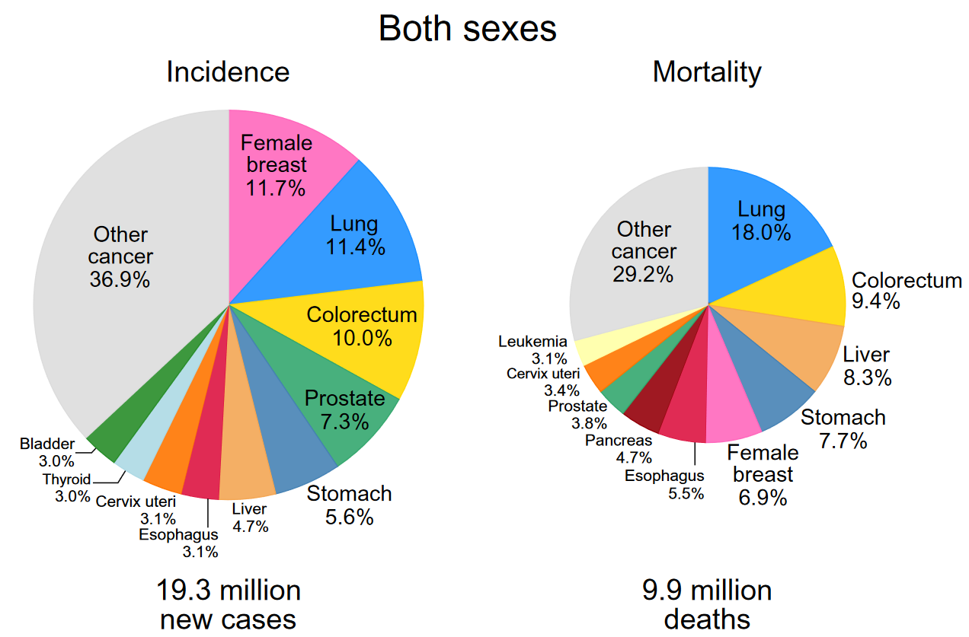
Universitat Oberta
de Catalunya
uoc.edu
INTRODUCTION
Fig 1. Distribution of incidence and mortality rates from the Top 10 Most Common Cancers in 2020 in Both Sexes. Image extracted from GLOBOCAN 2020.
Notes:
El

Slide 3
Universitat Oberta
de Catalunya
uoc.edu

Slide 4
Universitat Oberta
de Catalunya
uoc.edu

Slide 5
Universitat Oberta
de Catalunya
uoc.edu

Slide 6
Universitat Oberta
de Catalunya
uoc.edu

Slide 7
Universitat Oberta
de Catalunya
uoc.edu

Slide 8
Universitat Oberta
de Catalunya
uoc.edu

Slide 9
Universitat Oberta
de Catalunya
uoc.edu

Slide 10
Universitat Oberta
de Catalunya
uoc.edu

Slide 11
Universitat Oberta
de Catalunya
uoc.edu

Slide 12
Universitat Oberta
de Catalunya
uoc.edu

Slide 13
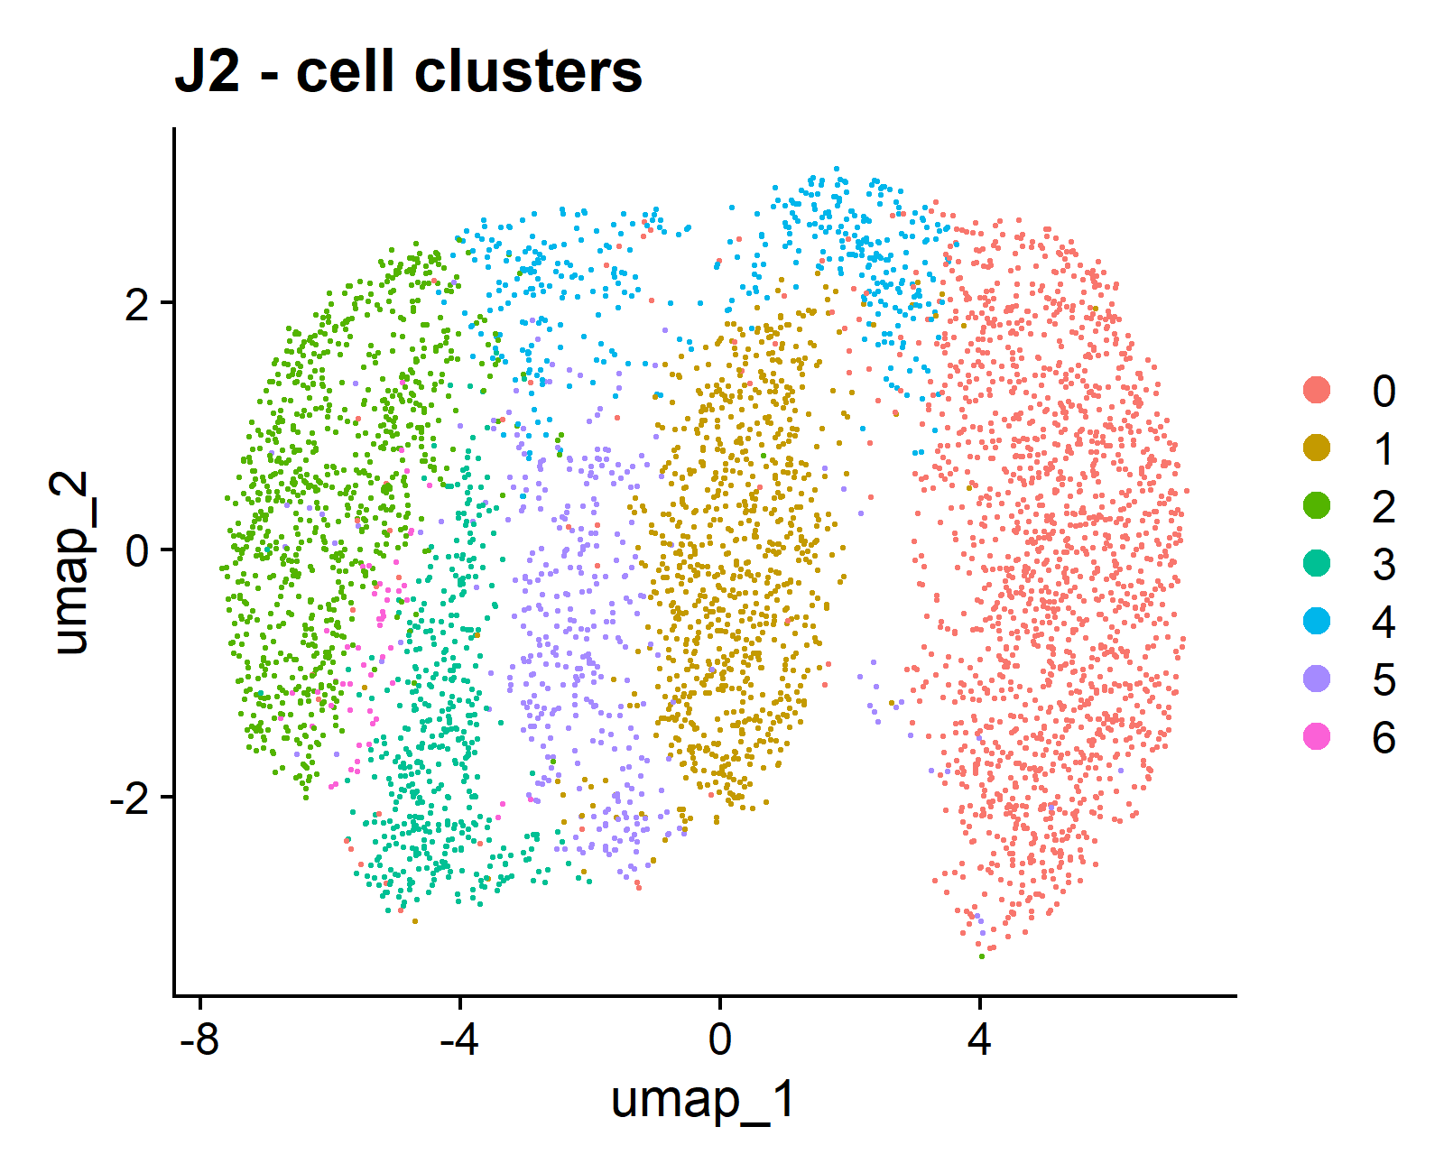
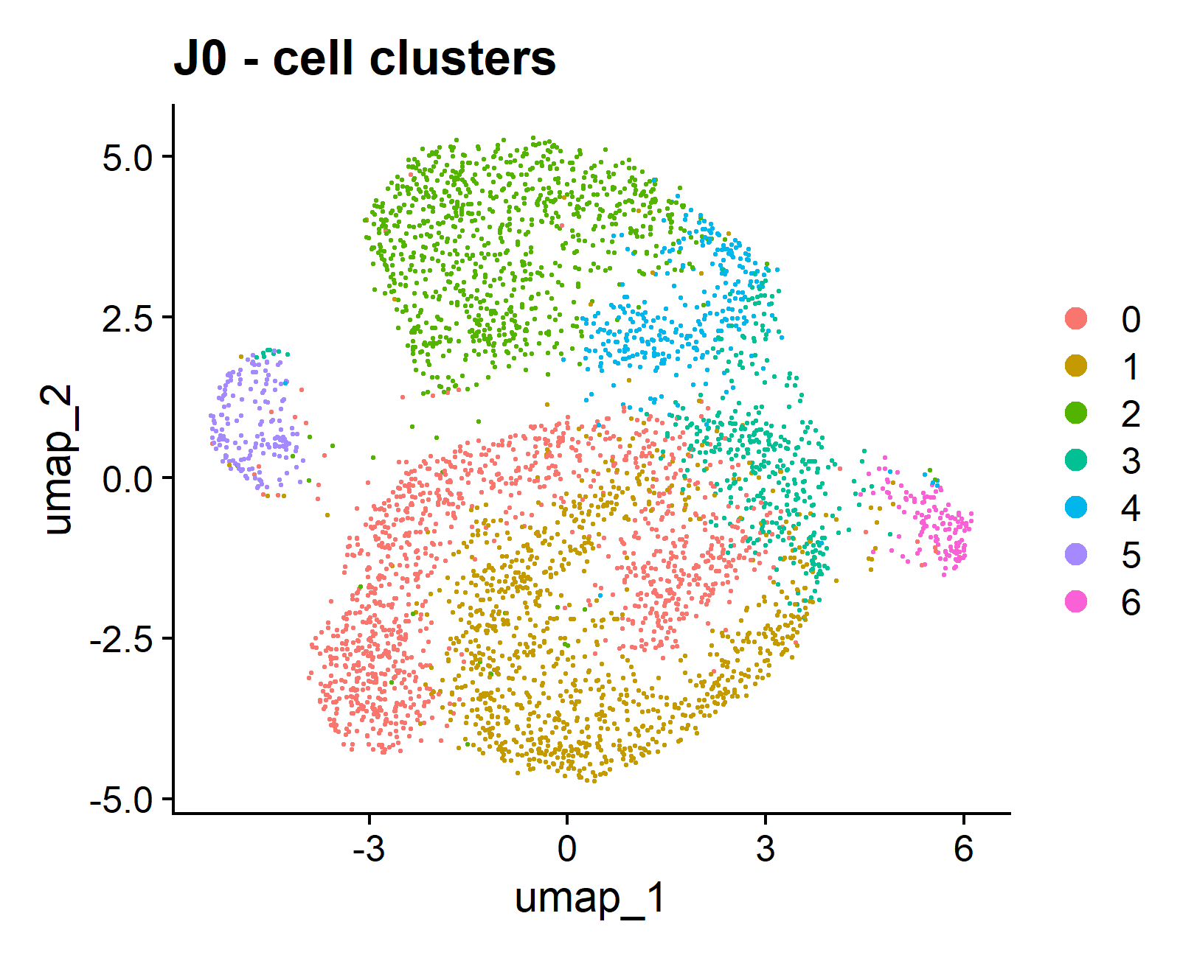
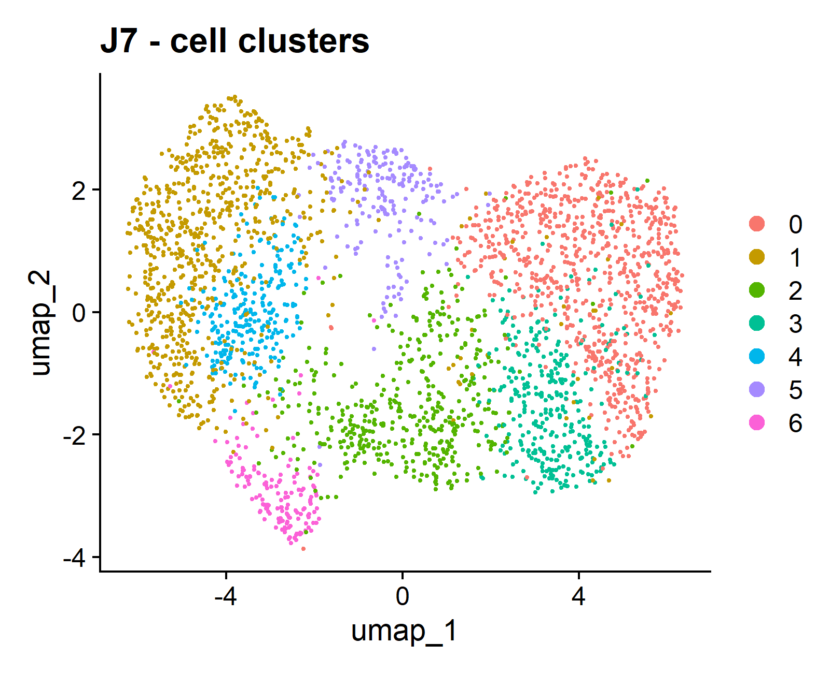
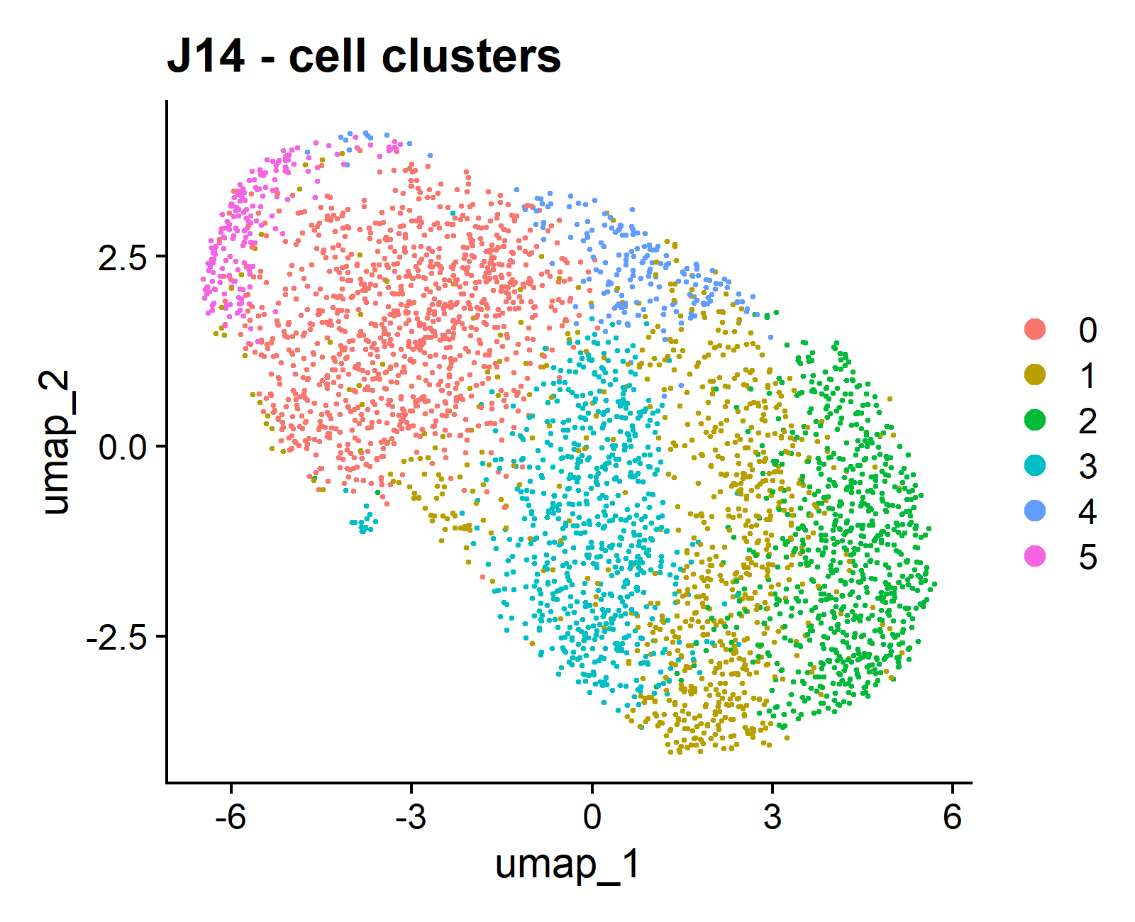
B)
A)
C)
D)
Notes:
Fig x. UMAPs by timepoints.

Slide 14
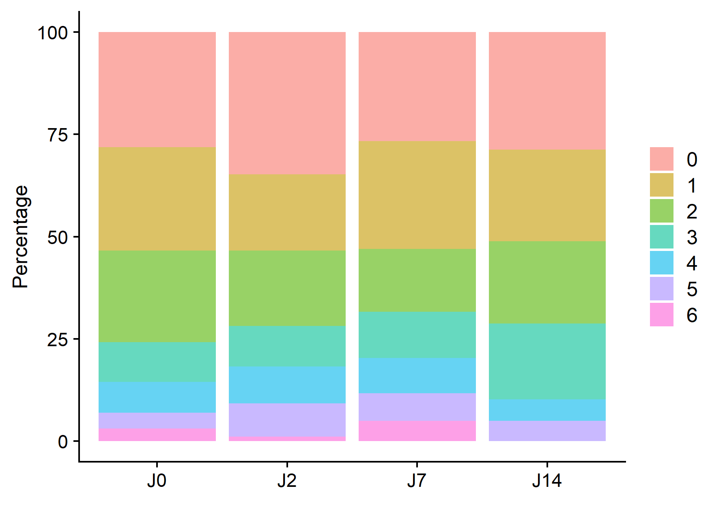
uoc.edu

Slide 15
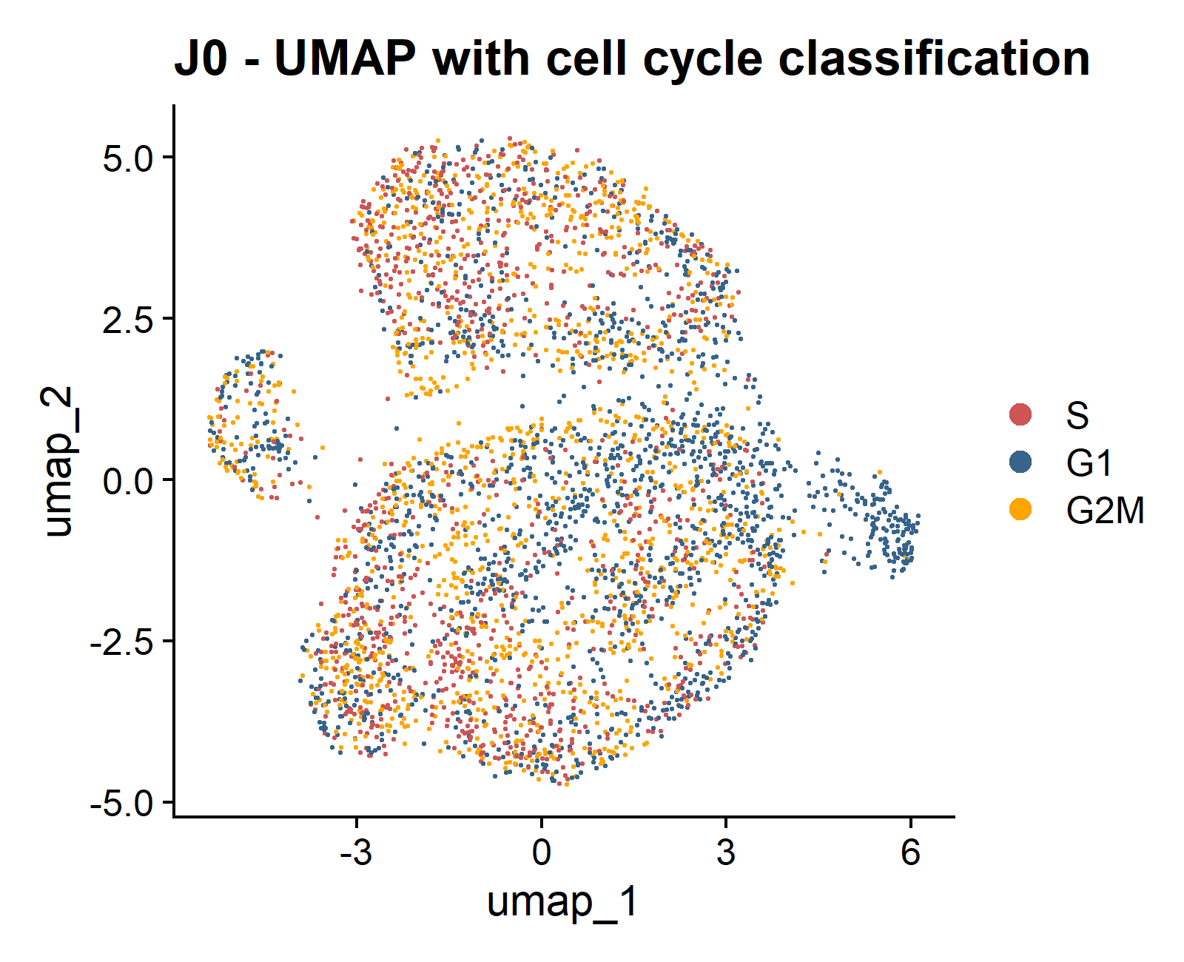
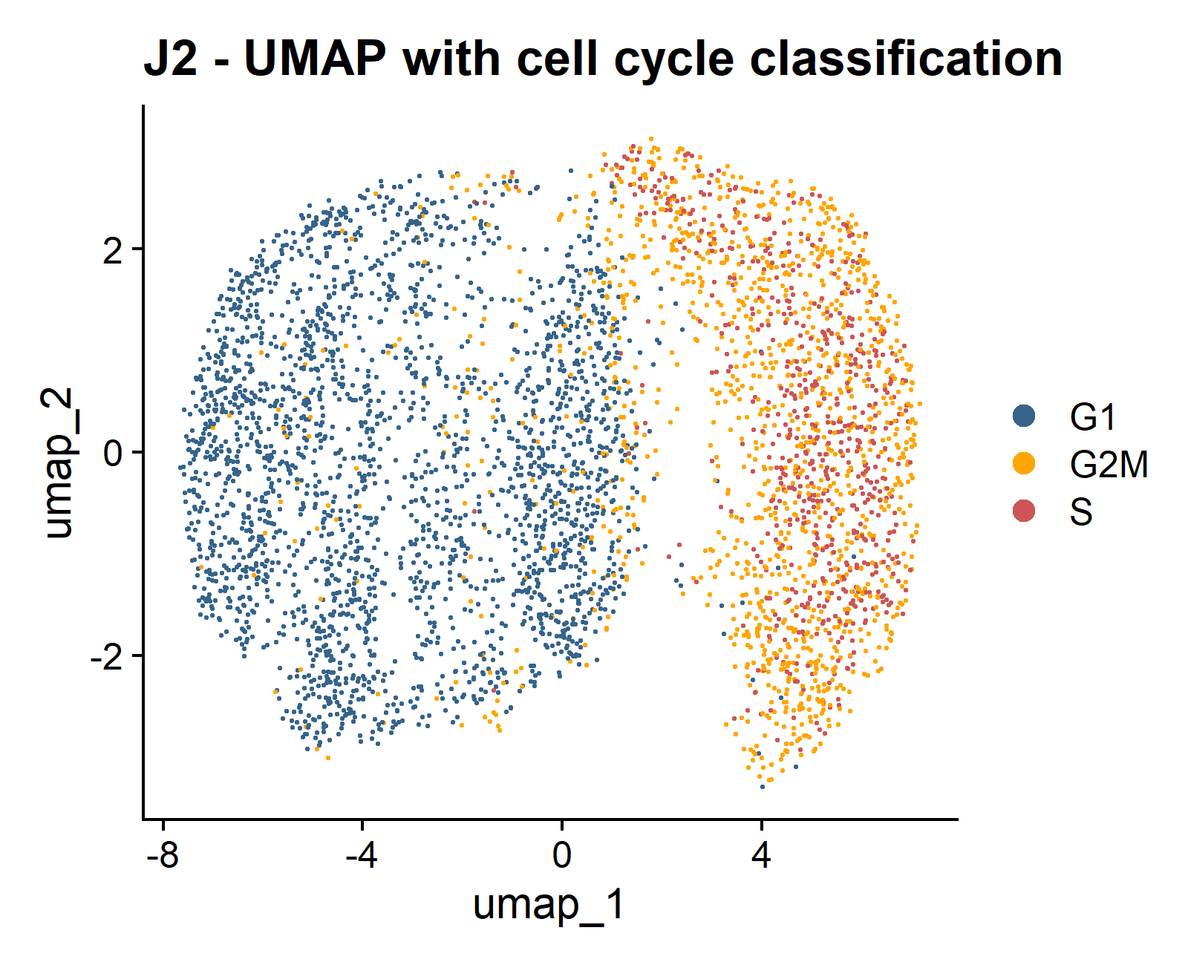
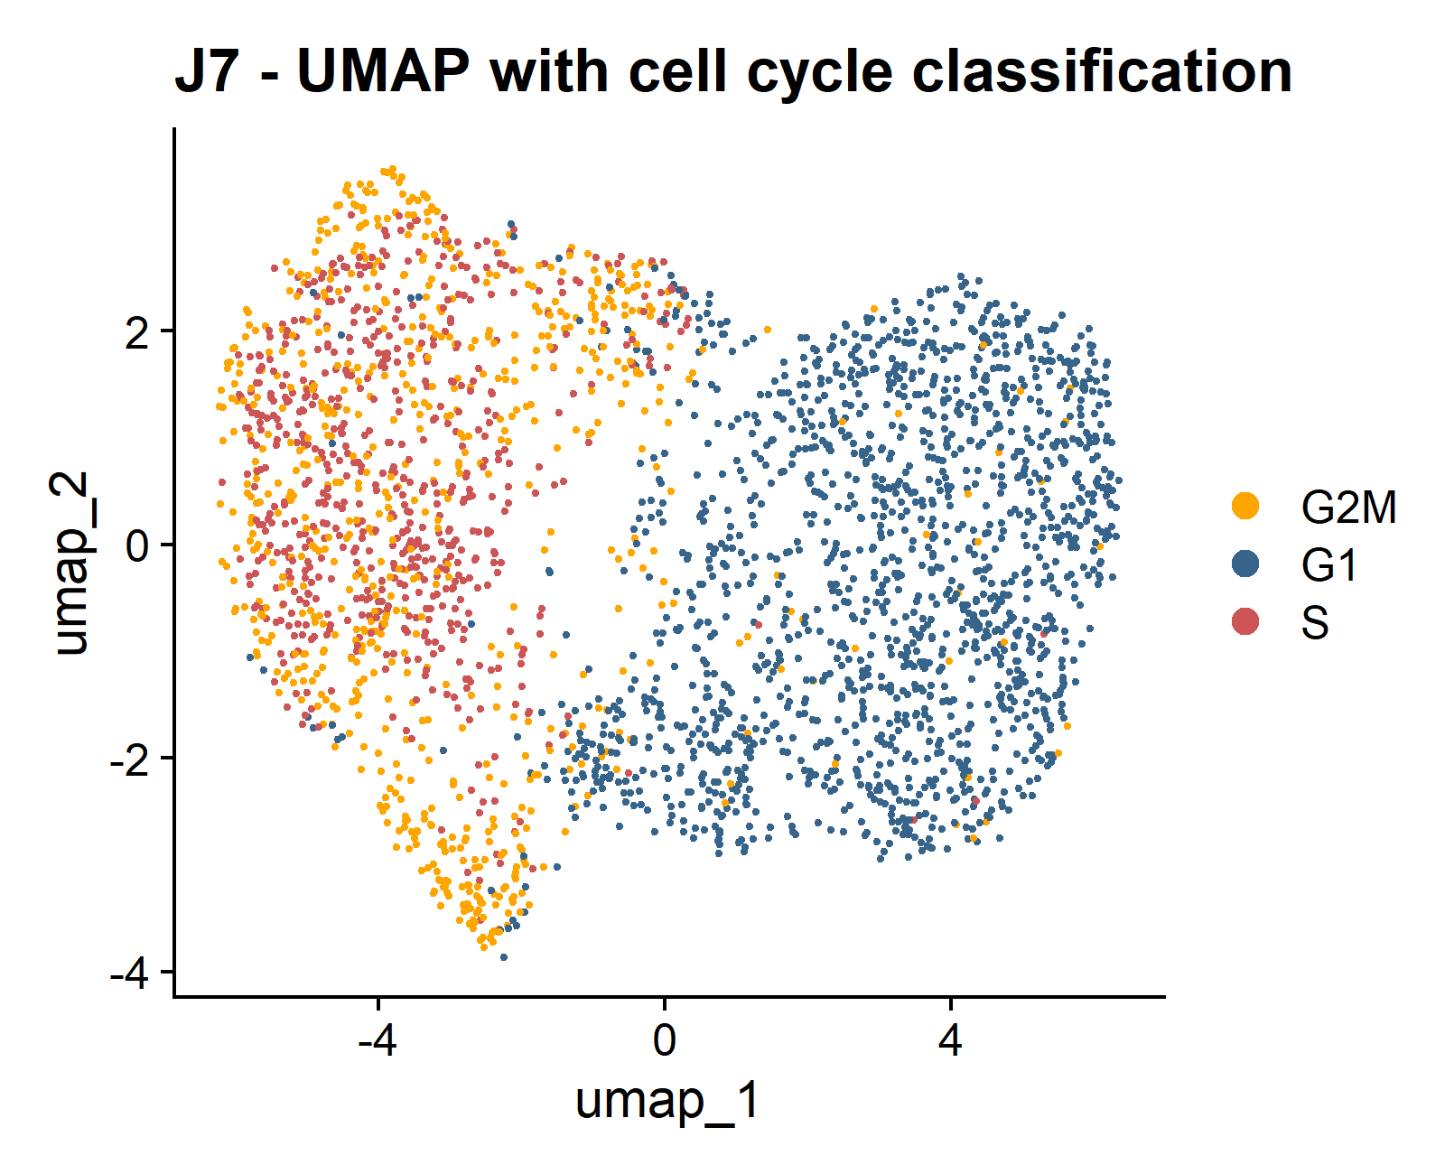
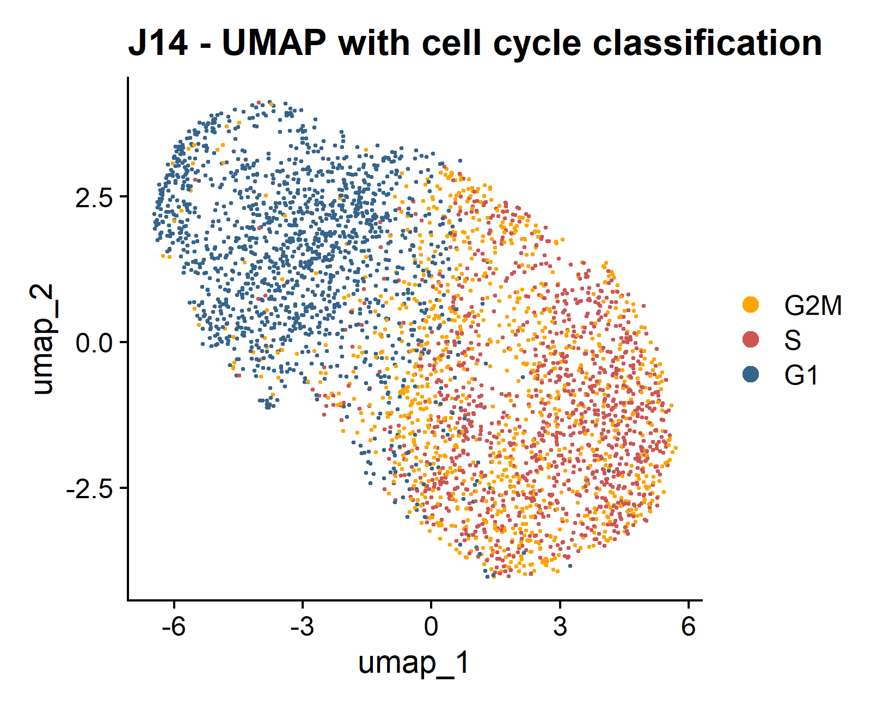
A)
B)
uoc.edu
C)
D)

Slide 16
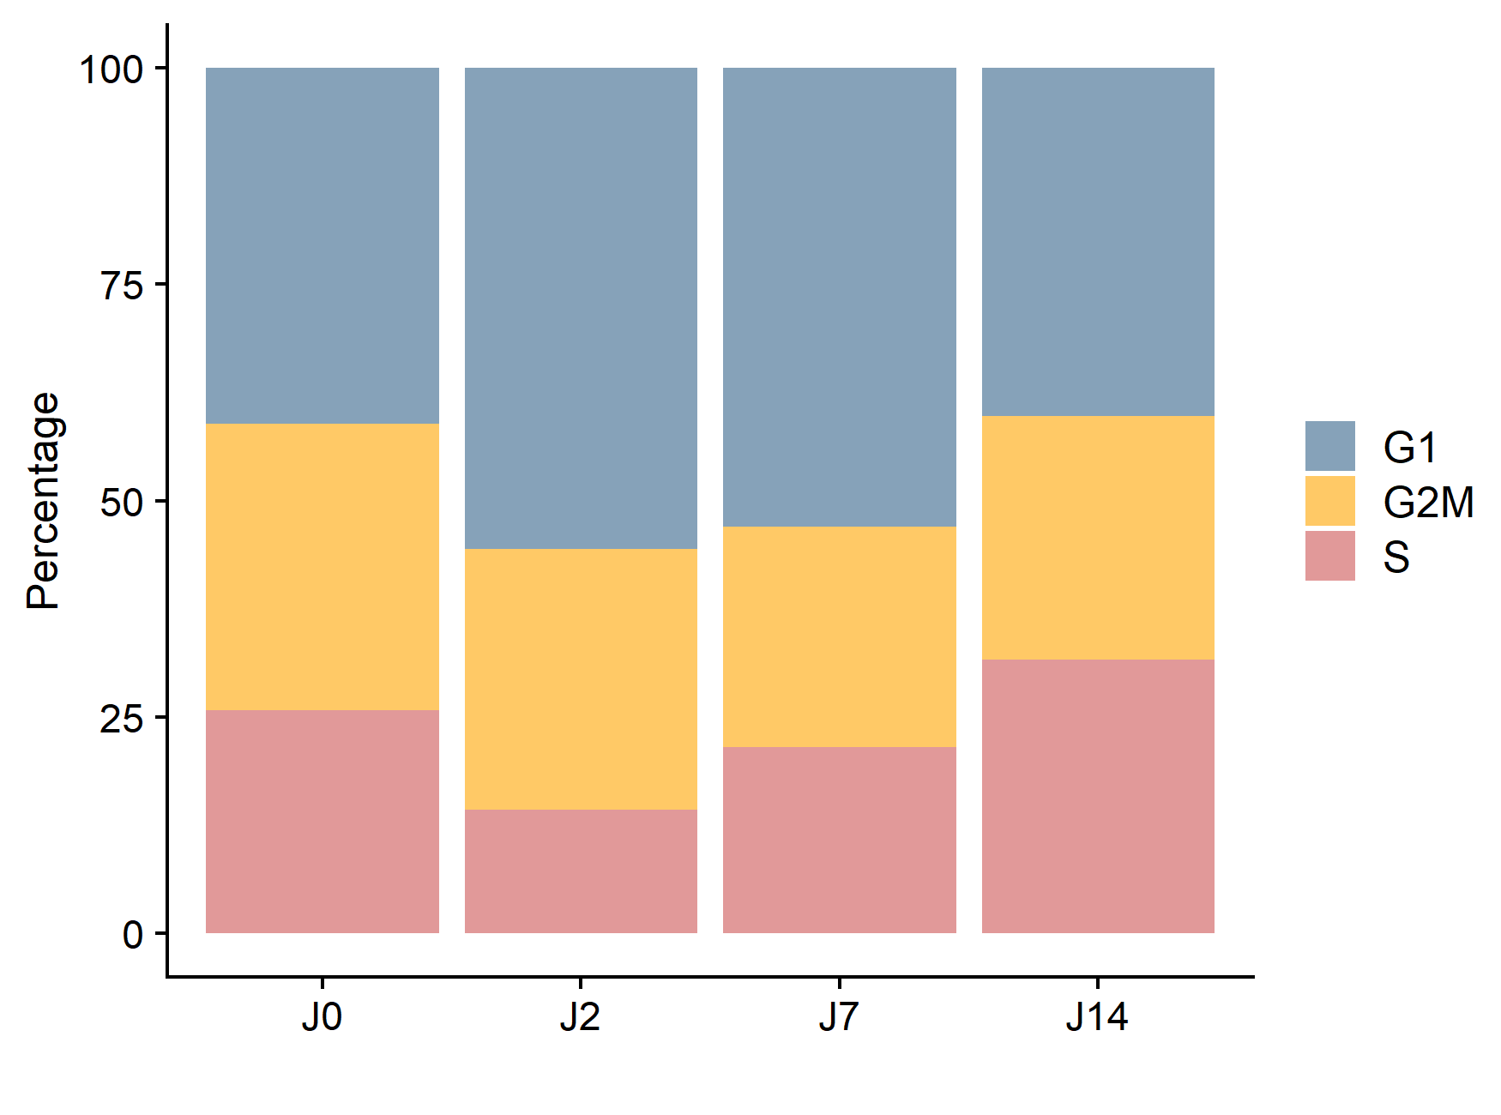
uoc.edu

Slide 17
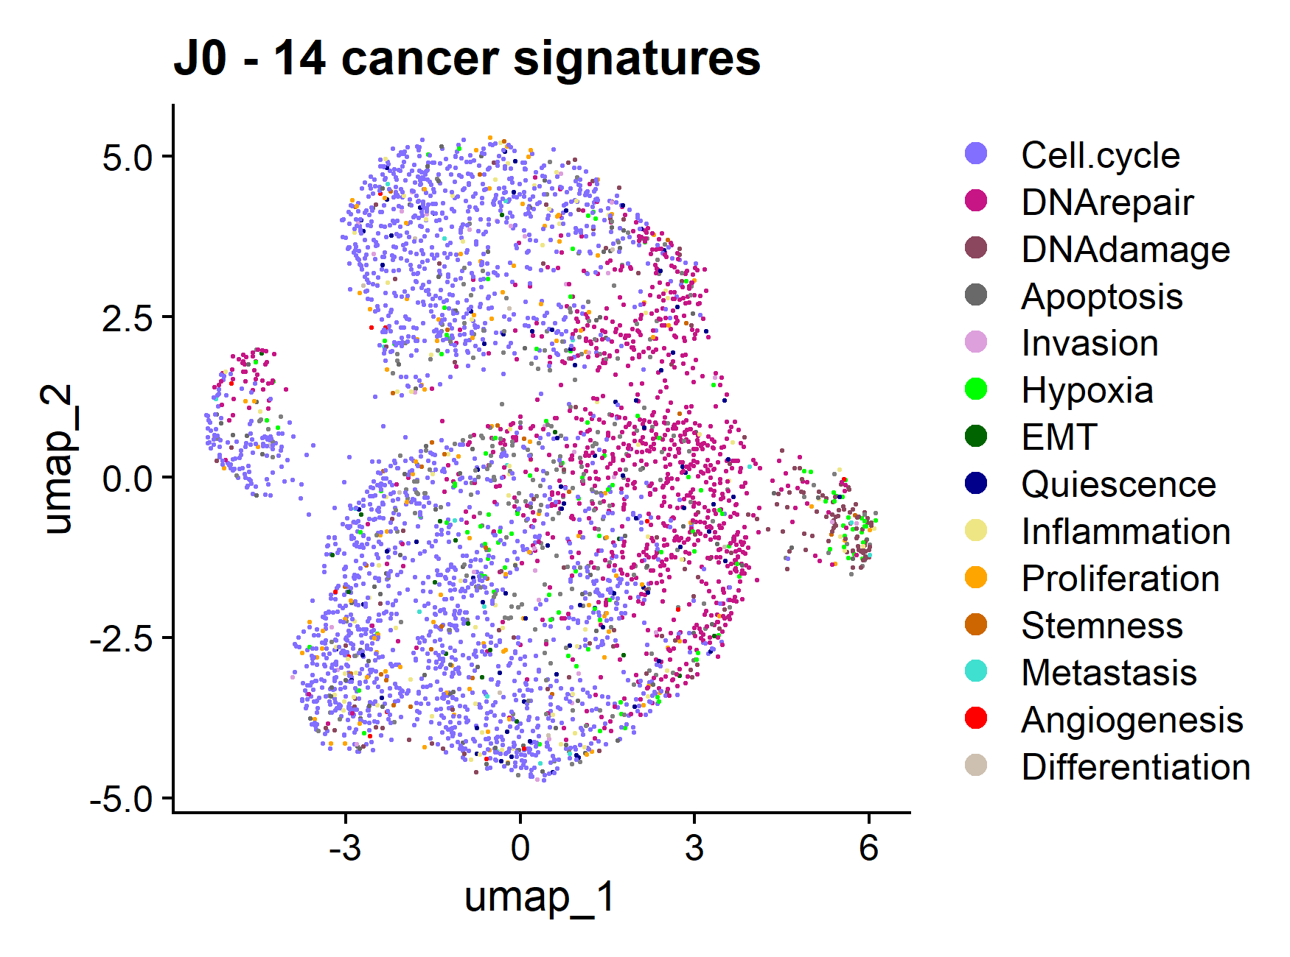
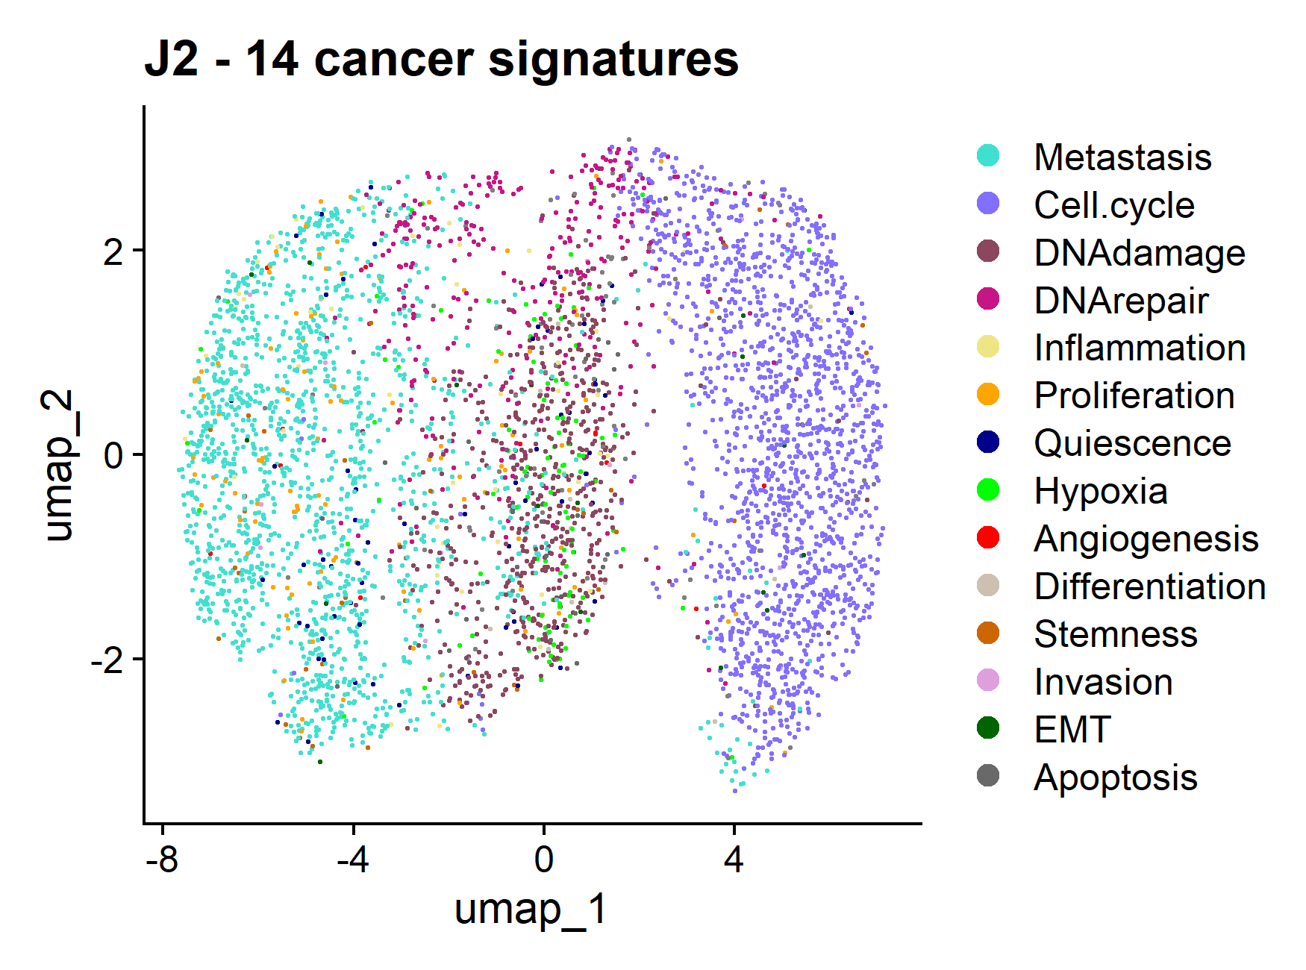
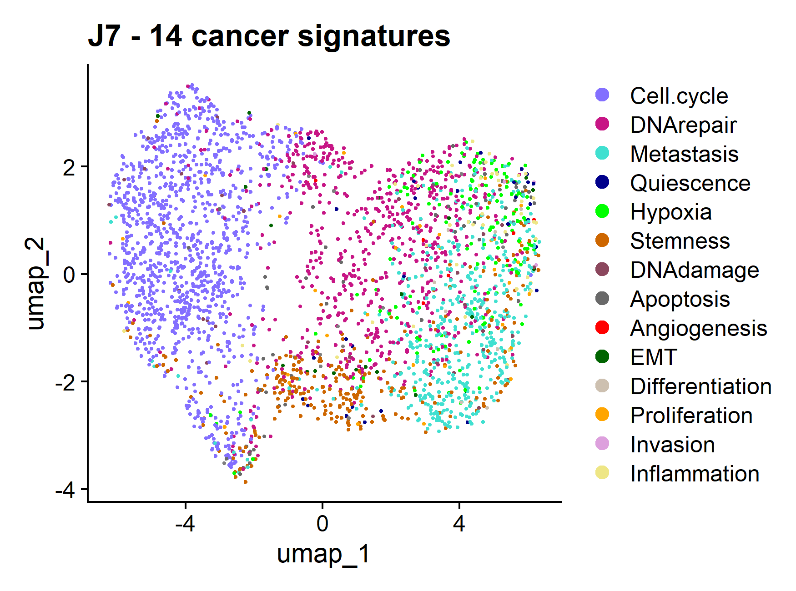
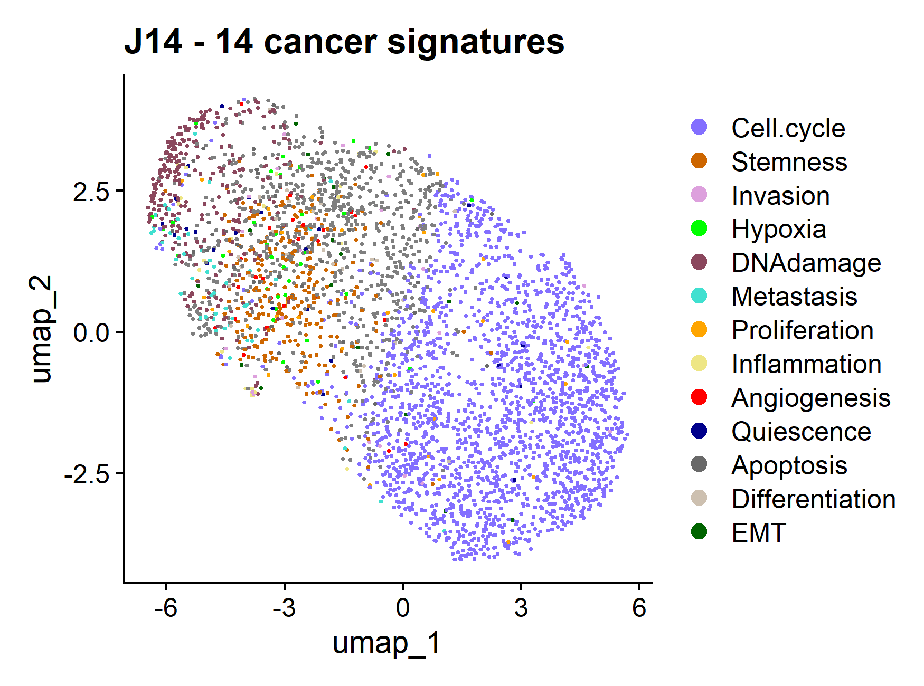
A)
B)
uoc.edu
C)
D)

Slide 18
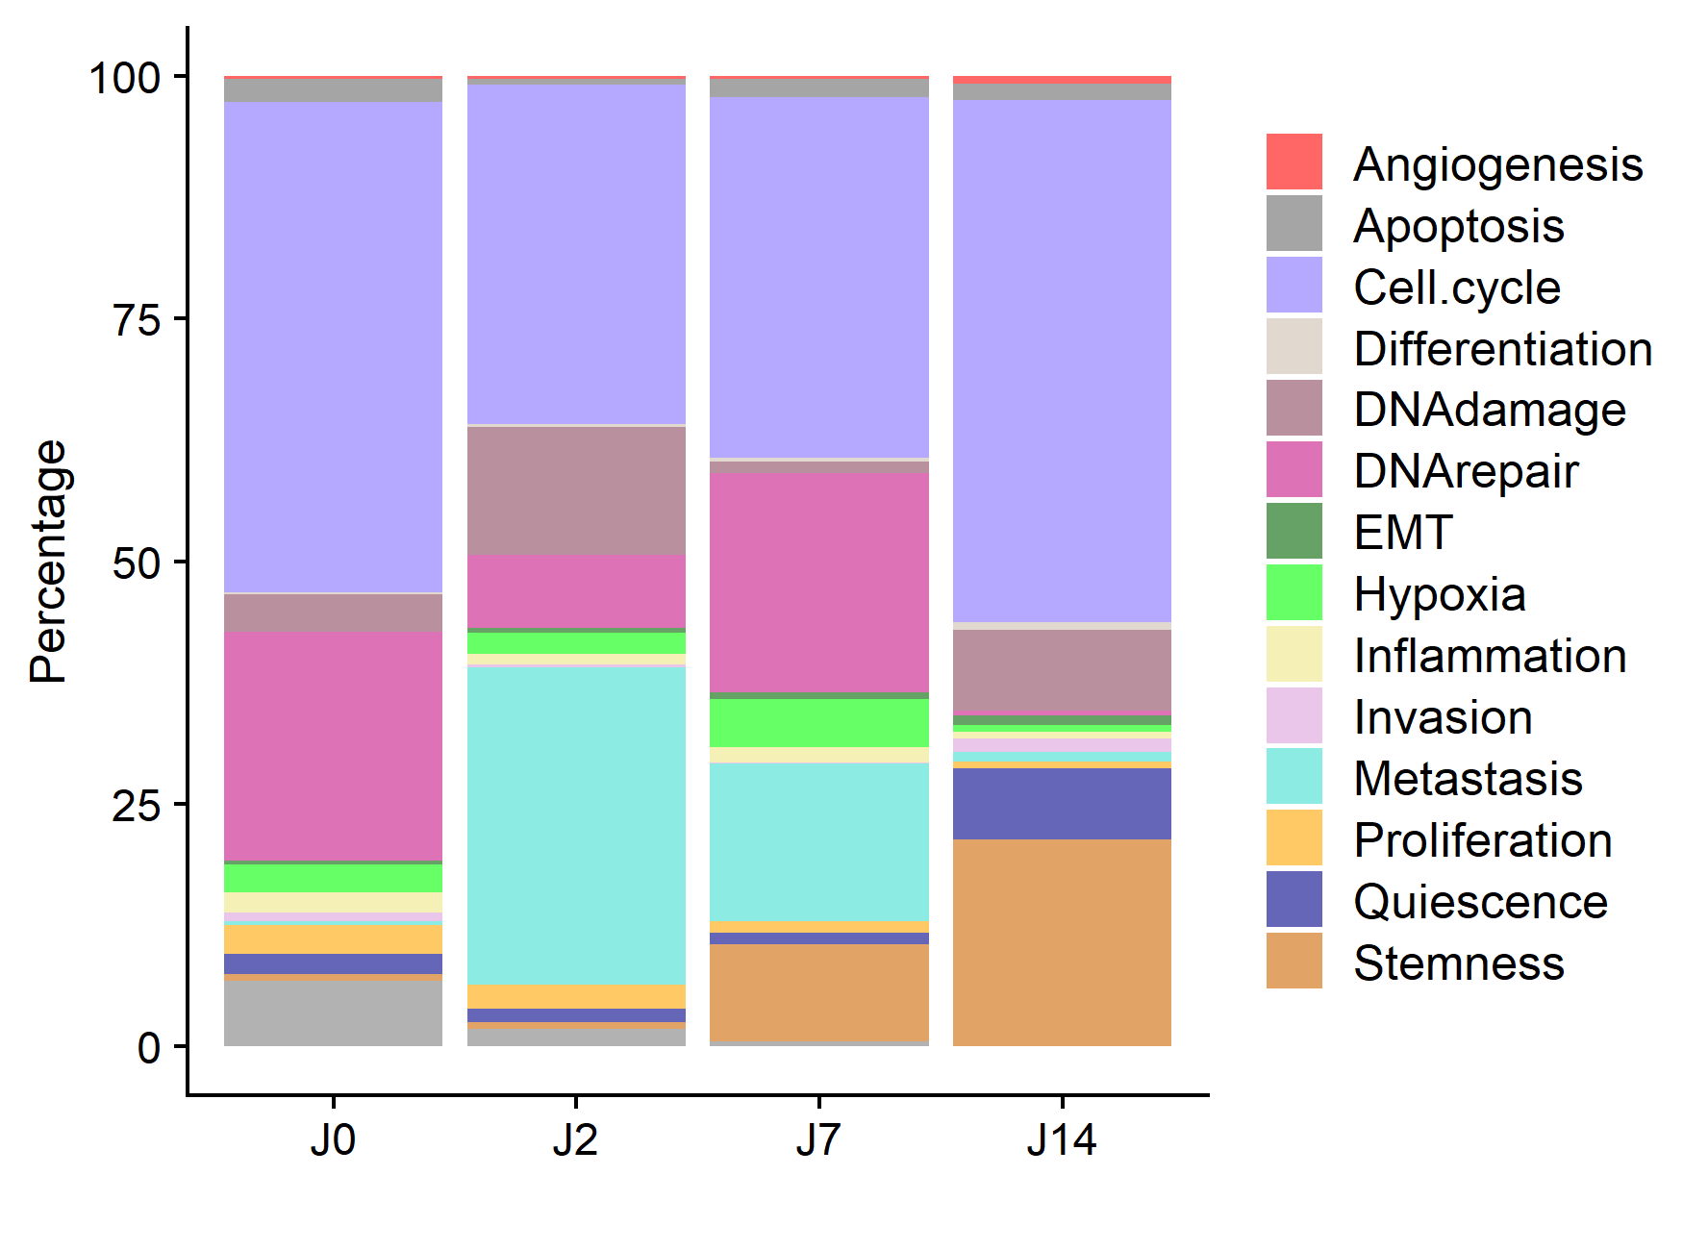
uoc.edu

Slide 19
INTERACTION CCC
uoc.edu

Slide 20
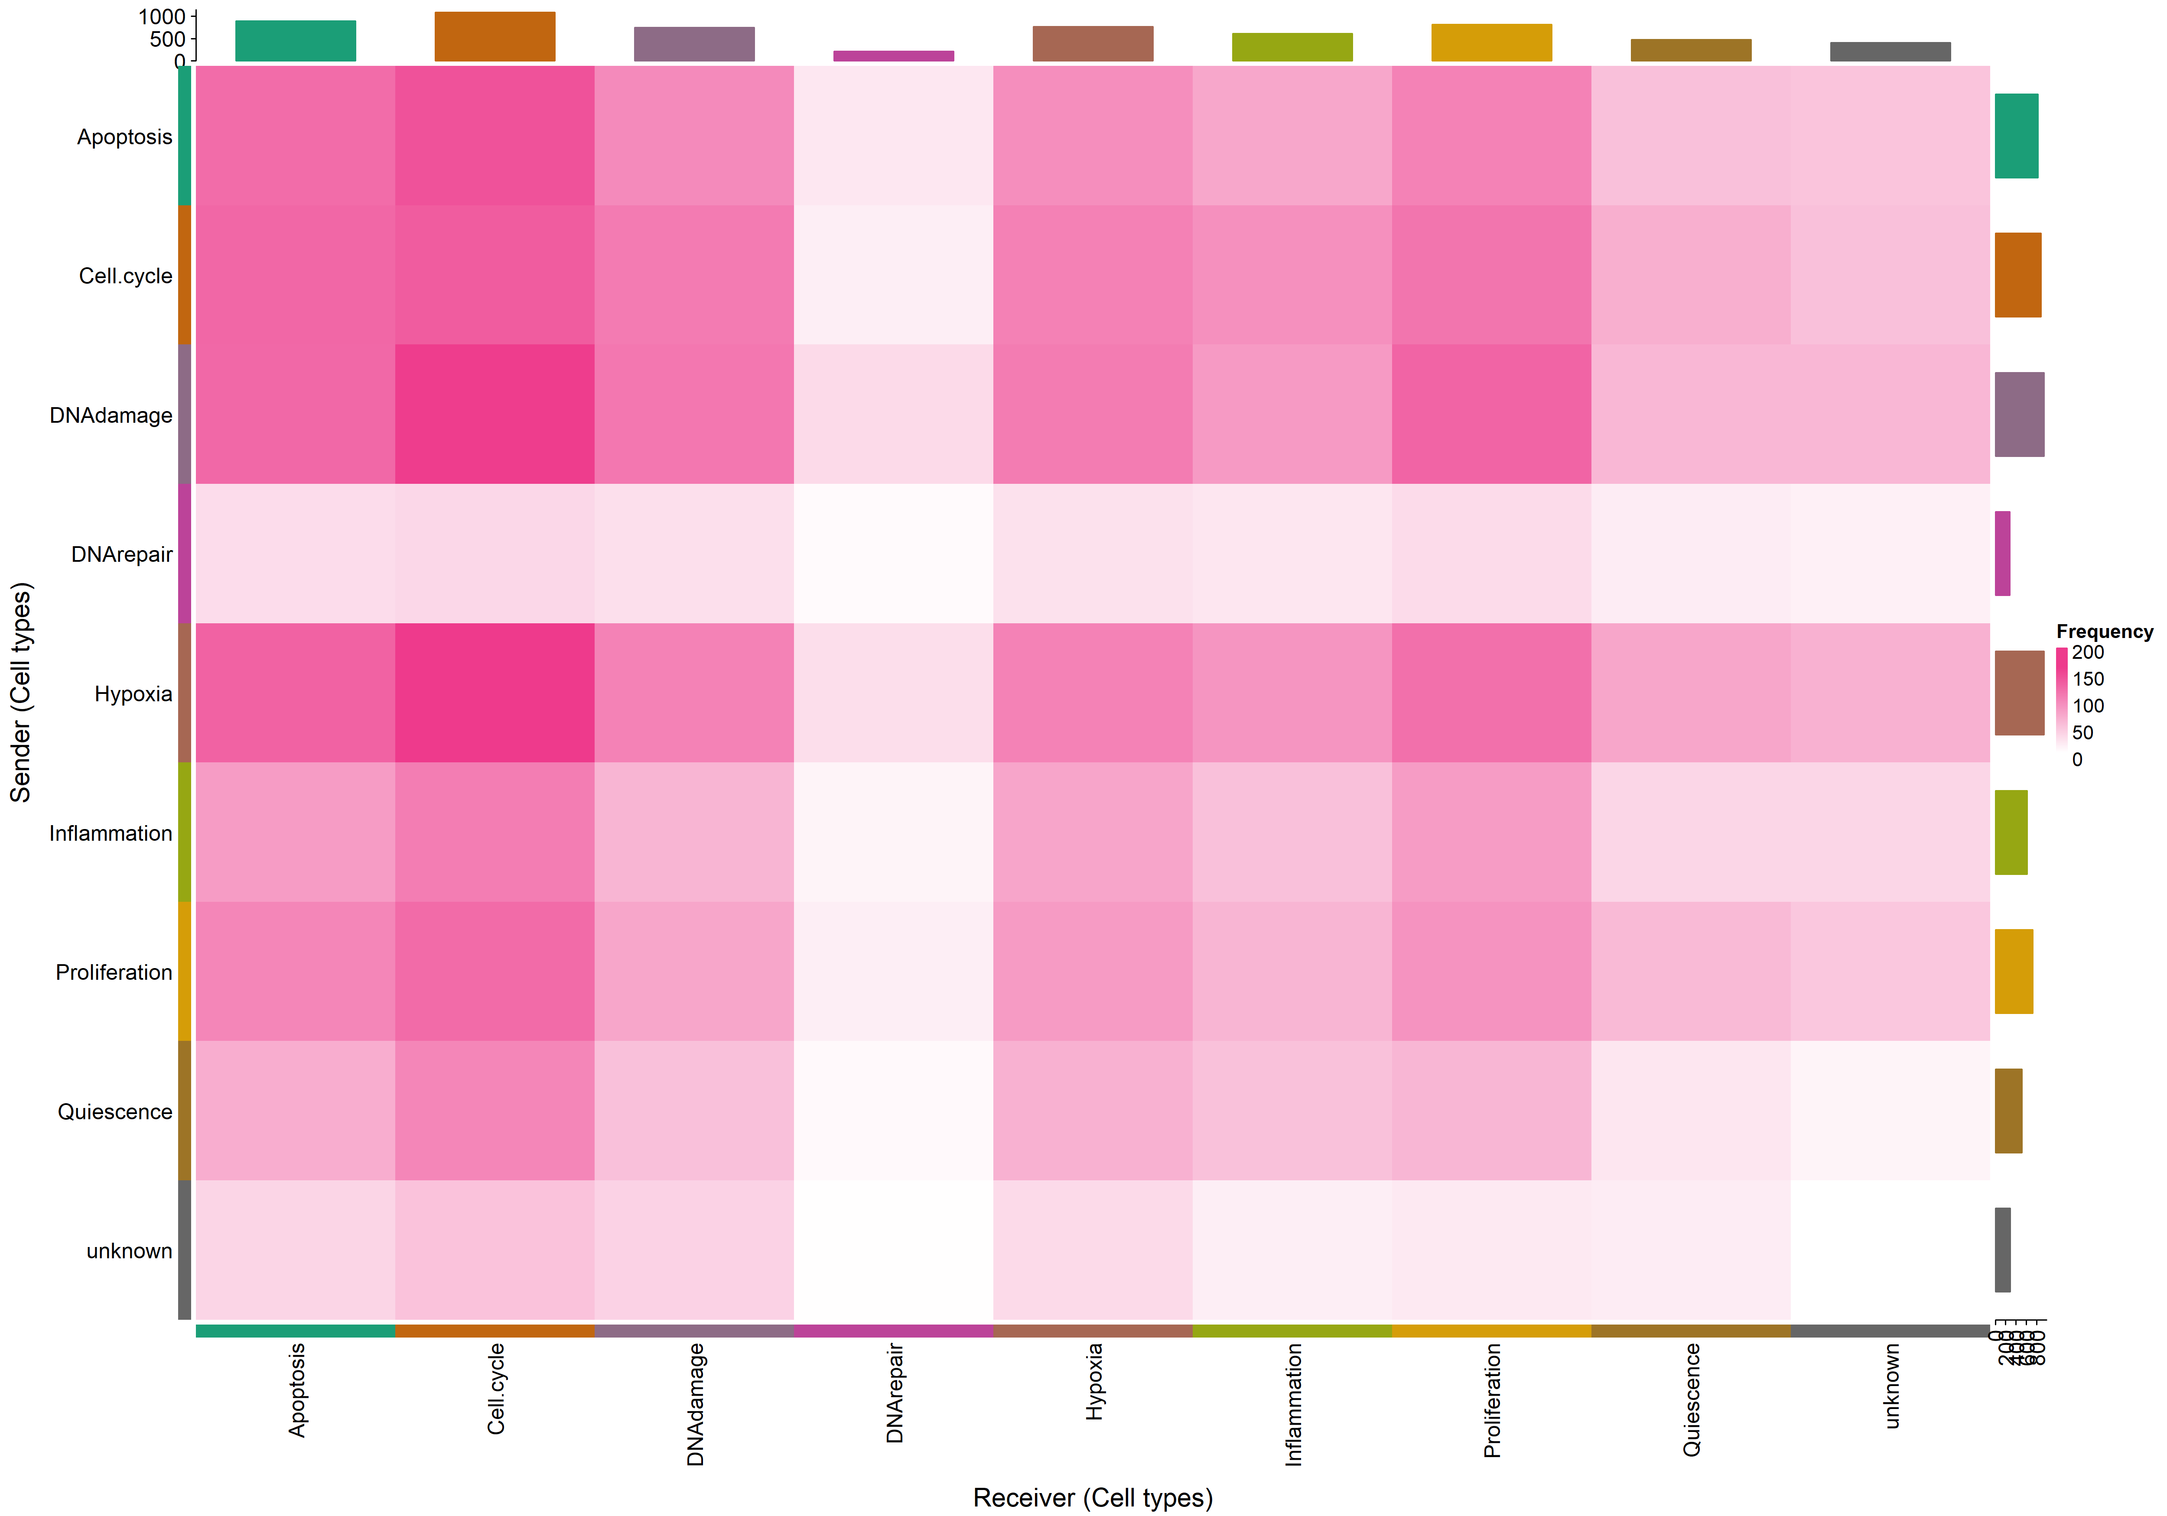
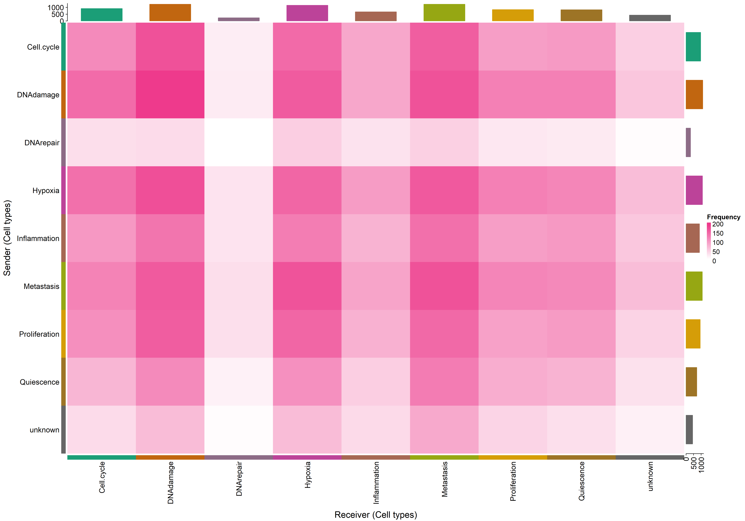
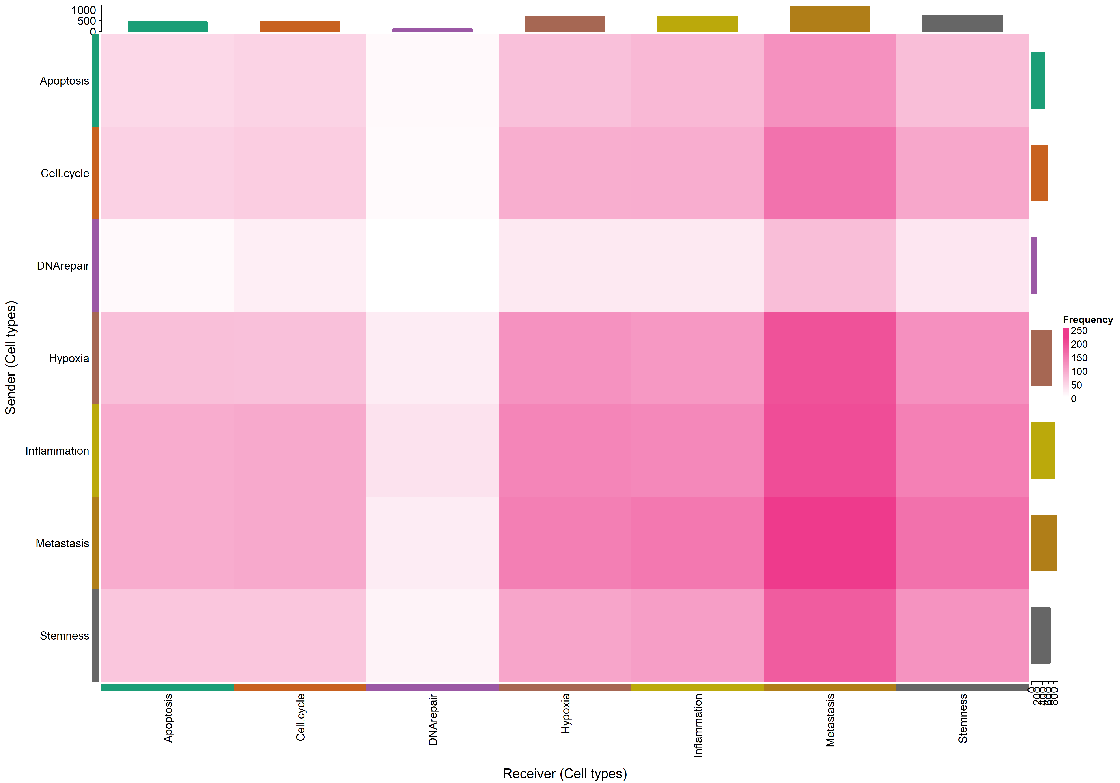
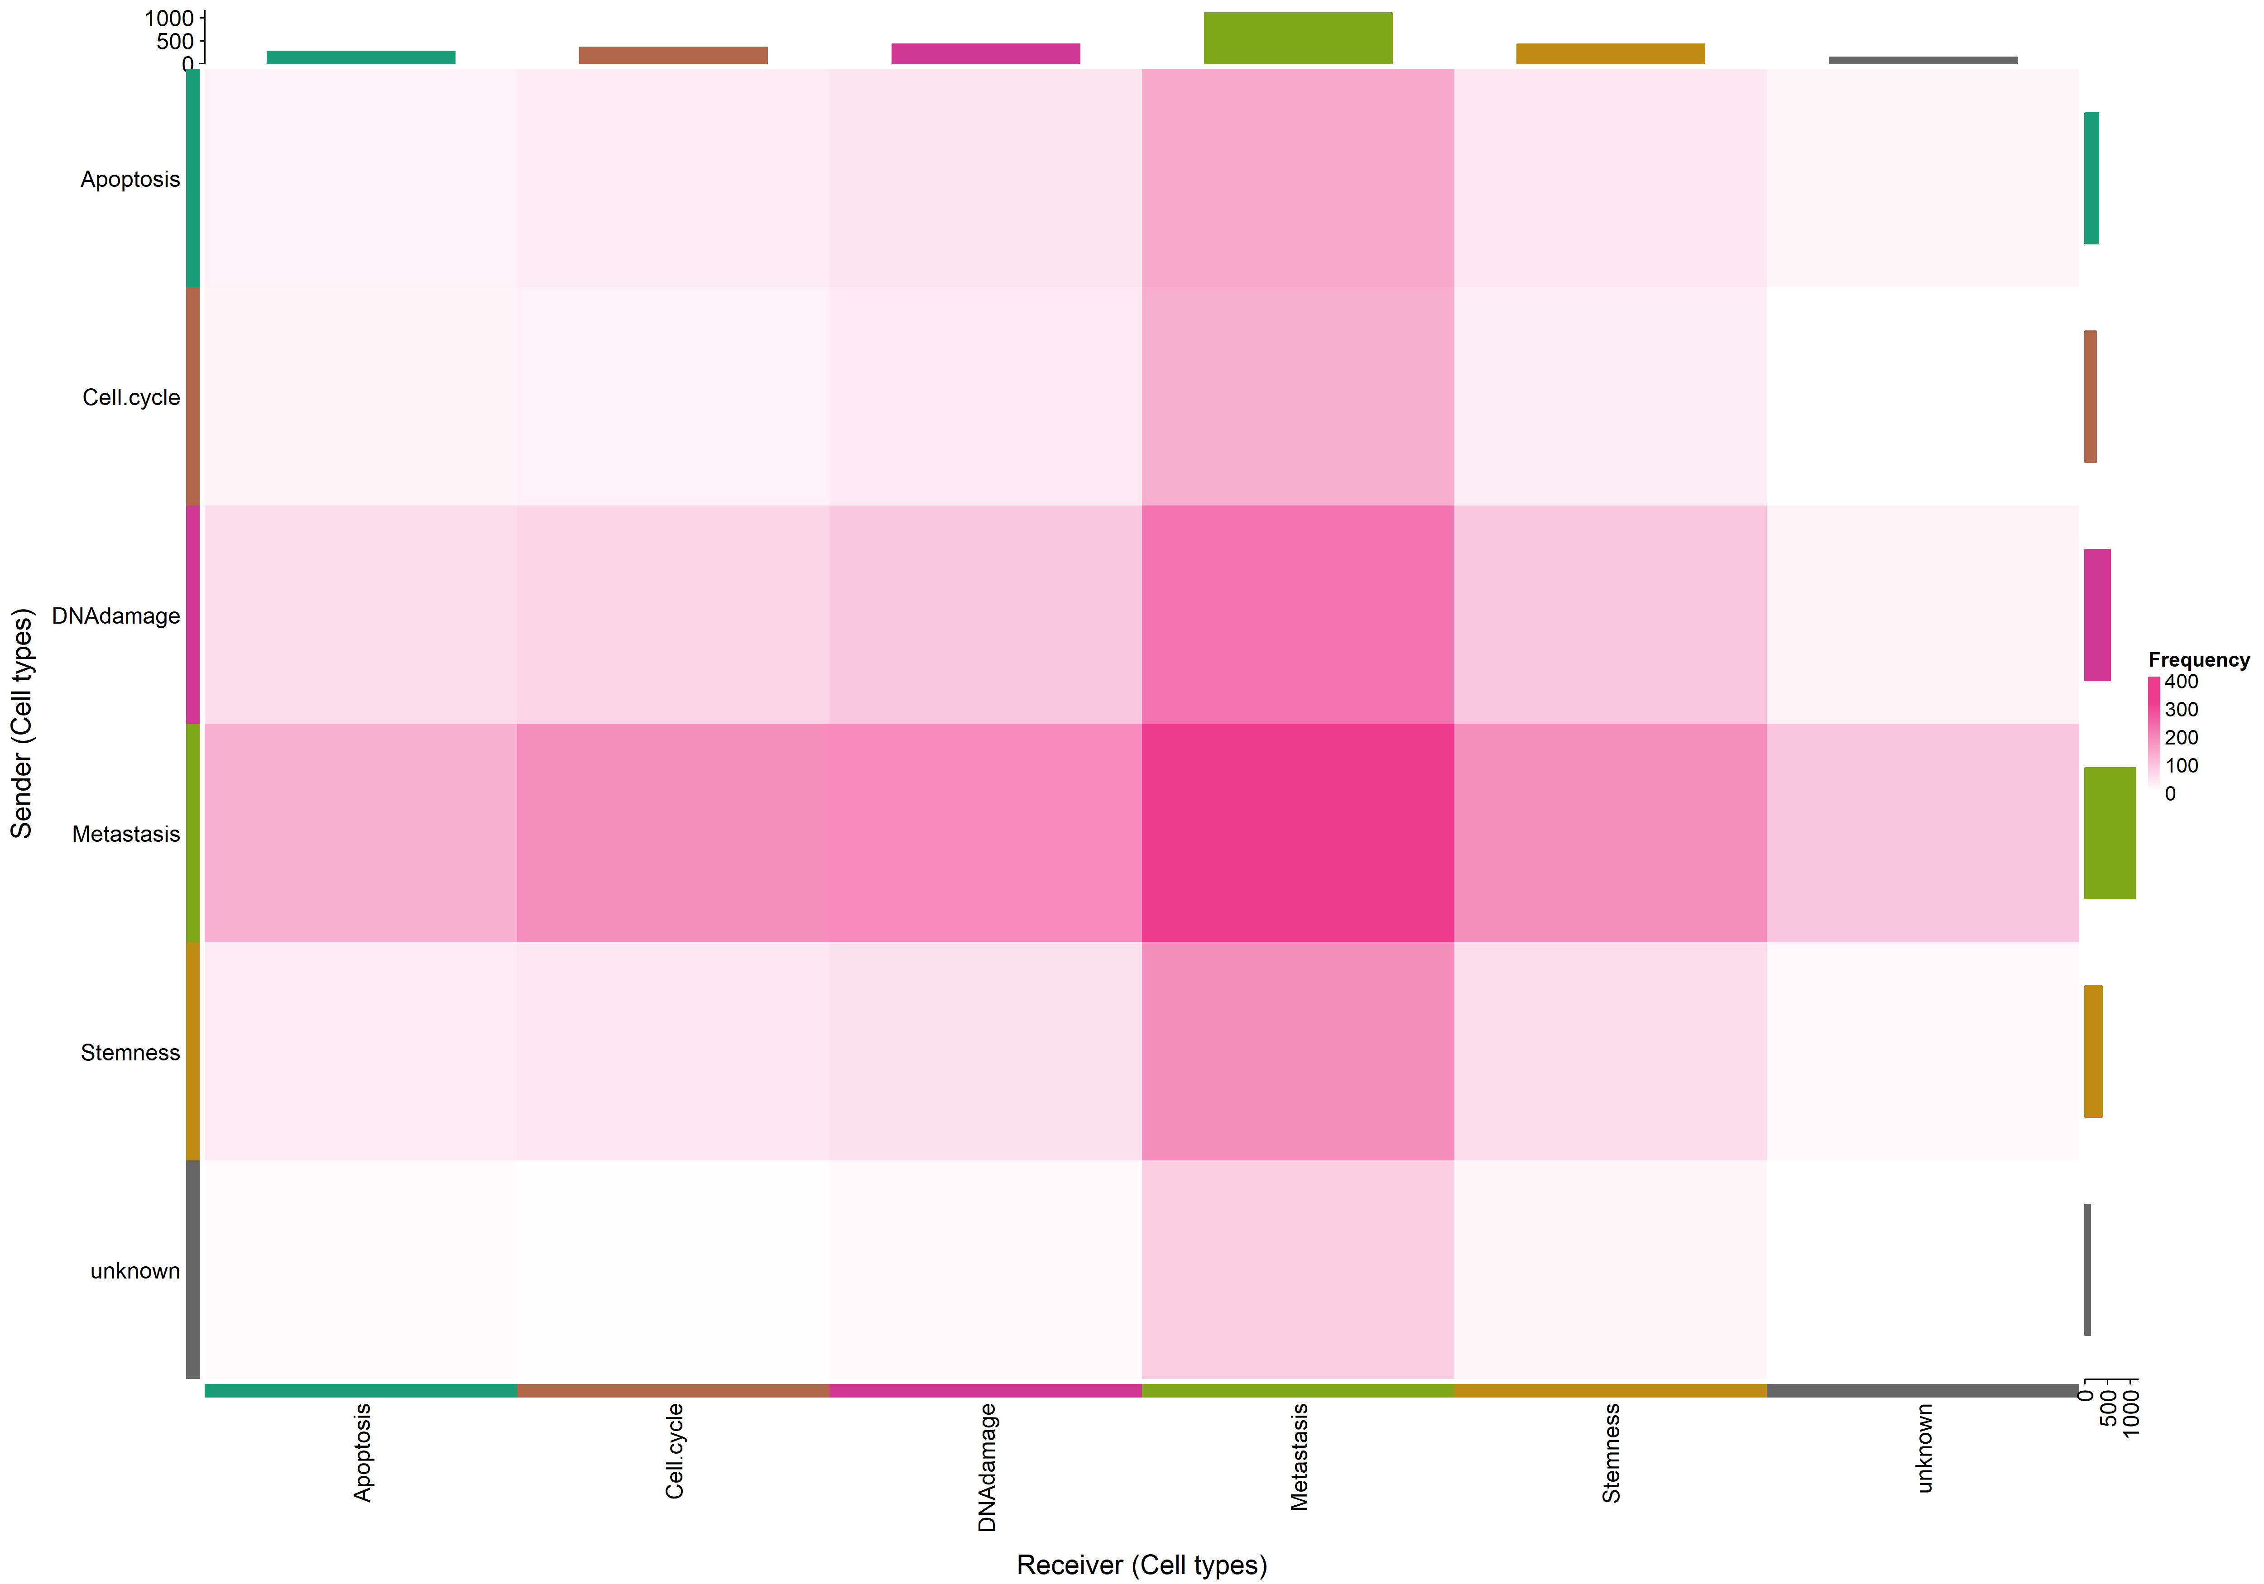
uoc.edu

Slide 21
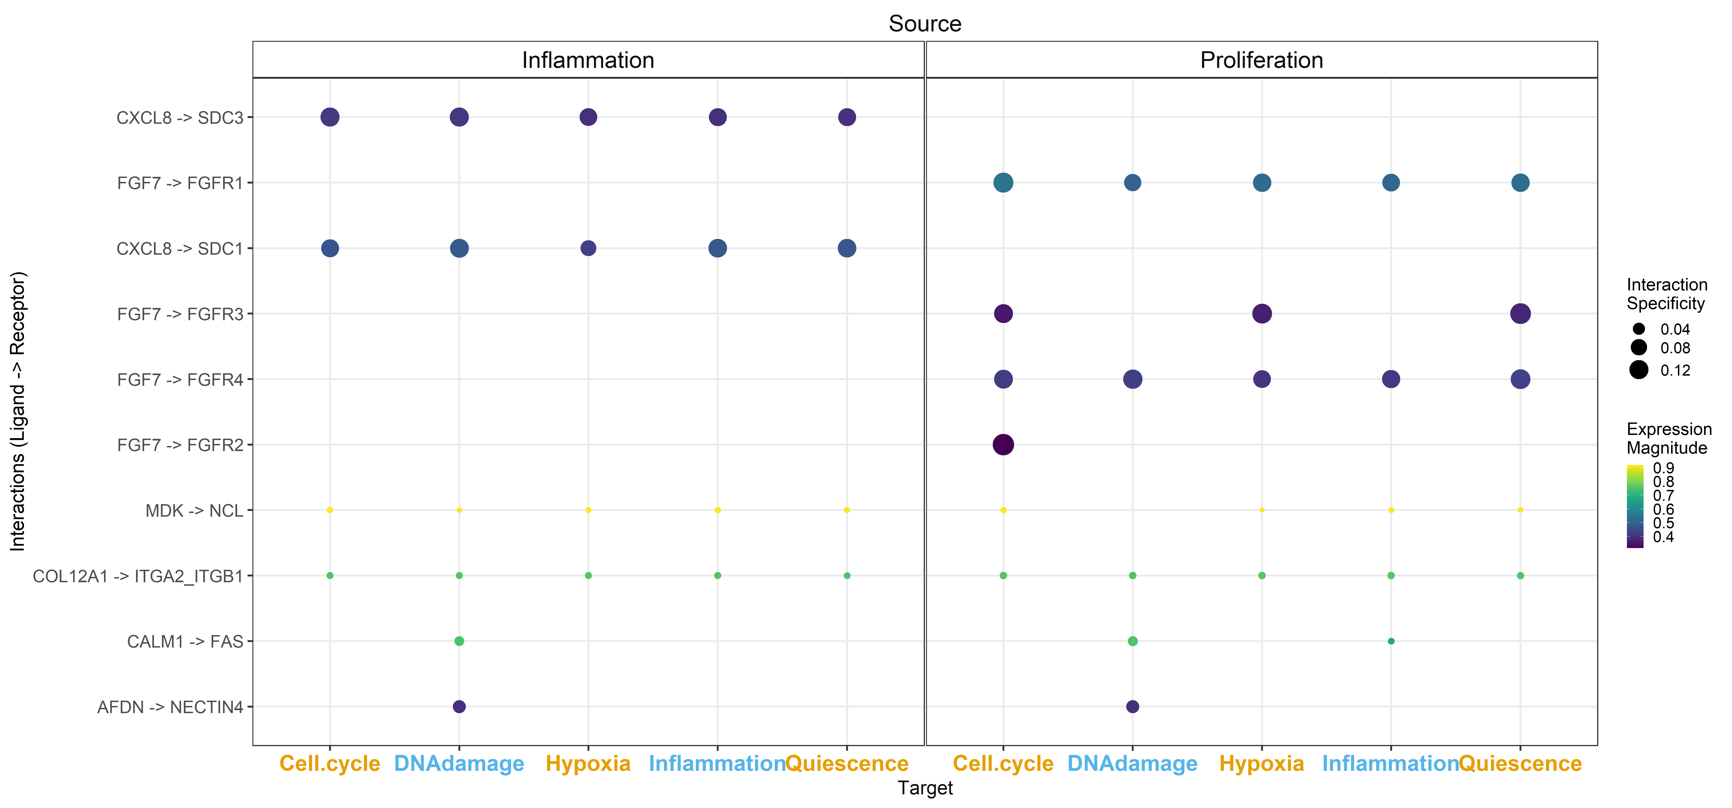
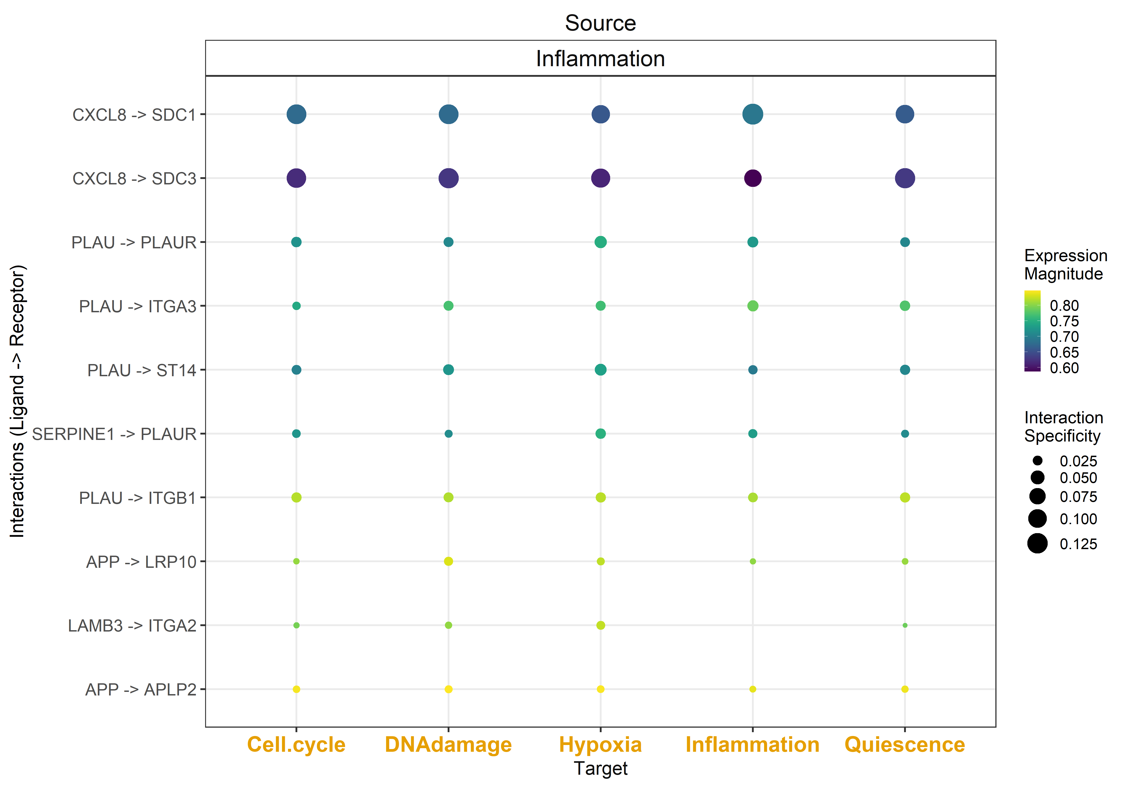
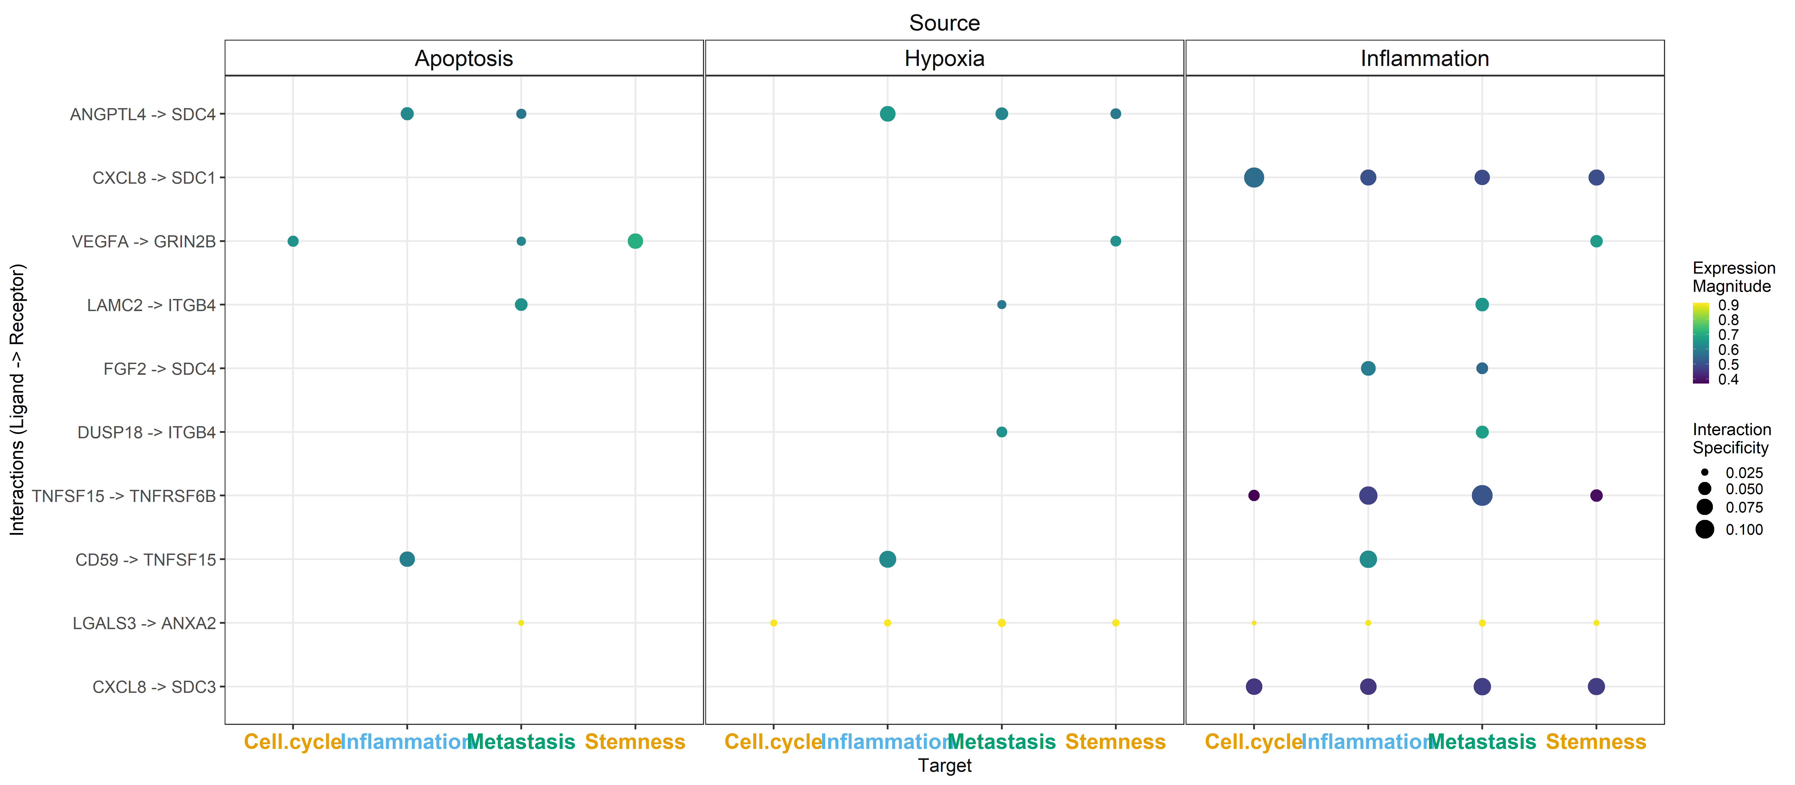
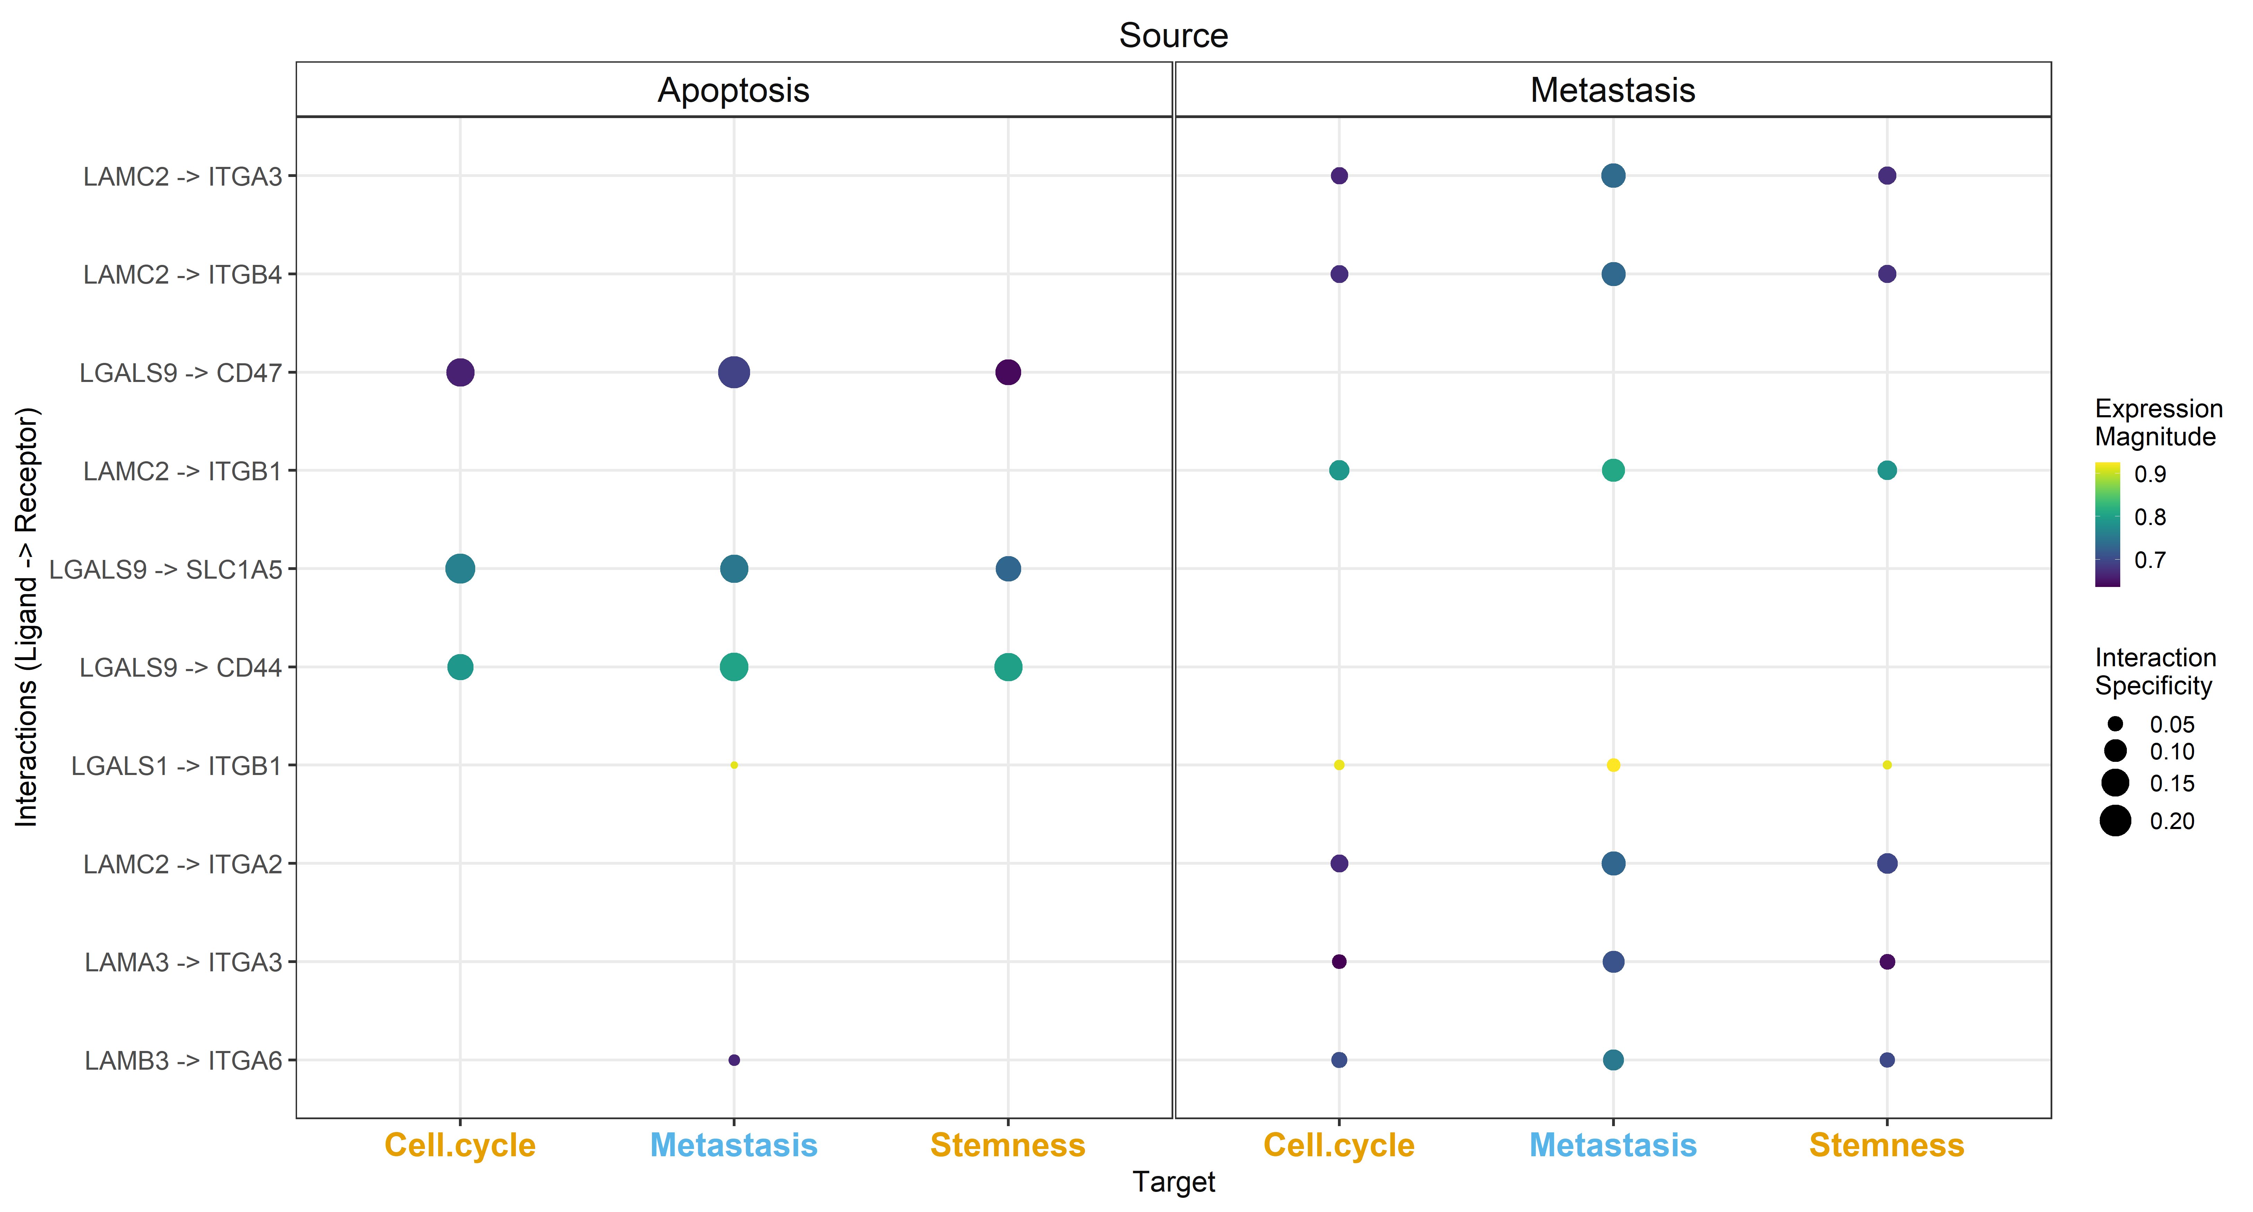
uoc.edu

Slide 22
INTEGRATIVE
uoc.edu

Slide 23
uoc.edu

Slide 24
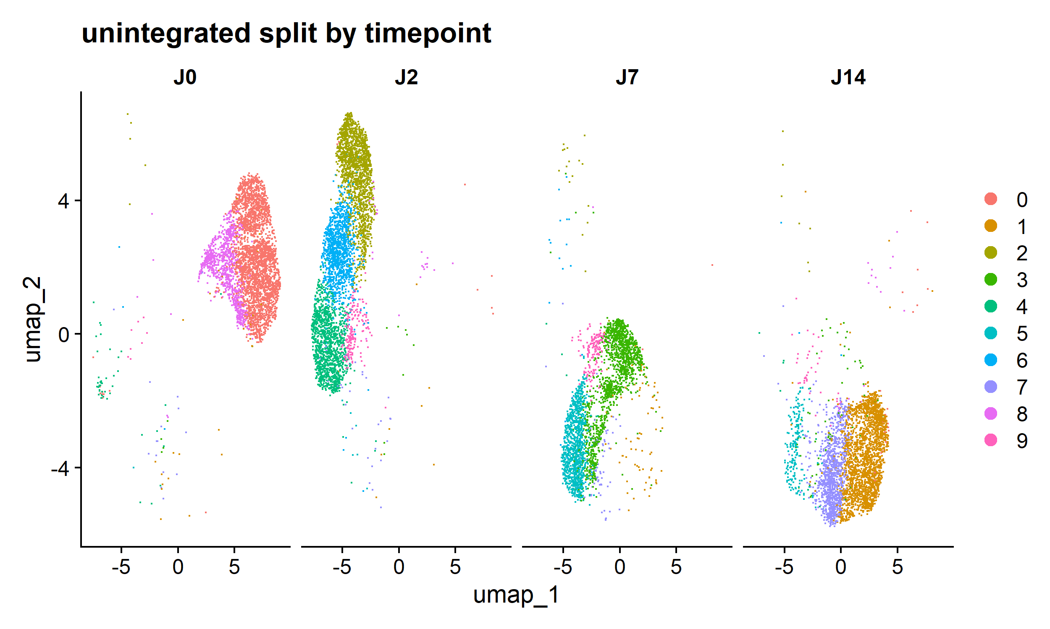
uoc.edu

Slide 25
uoc.edu

Slide 26
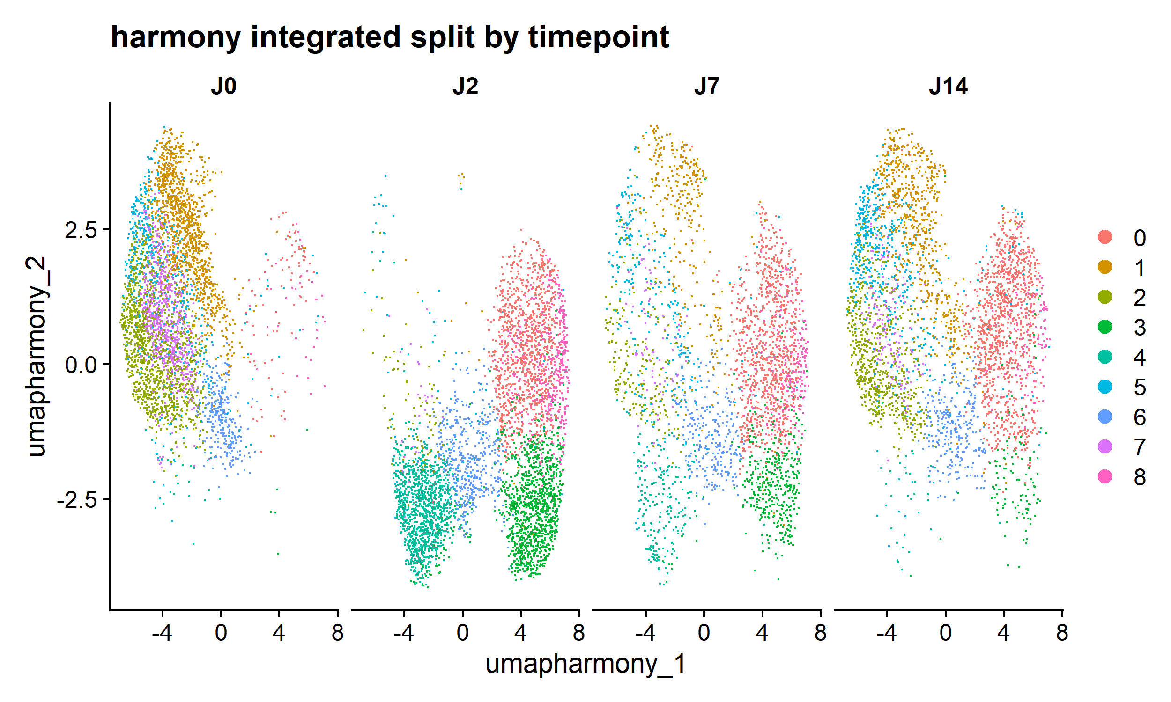
uoc.edu

Slide 27
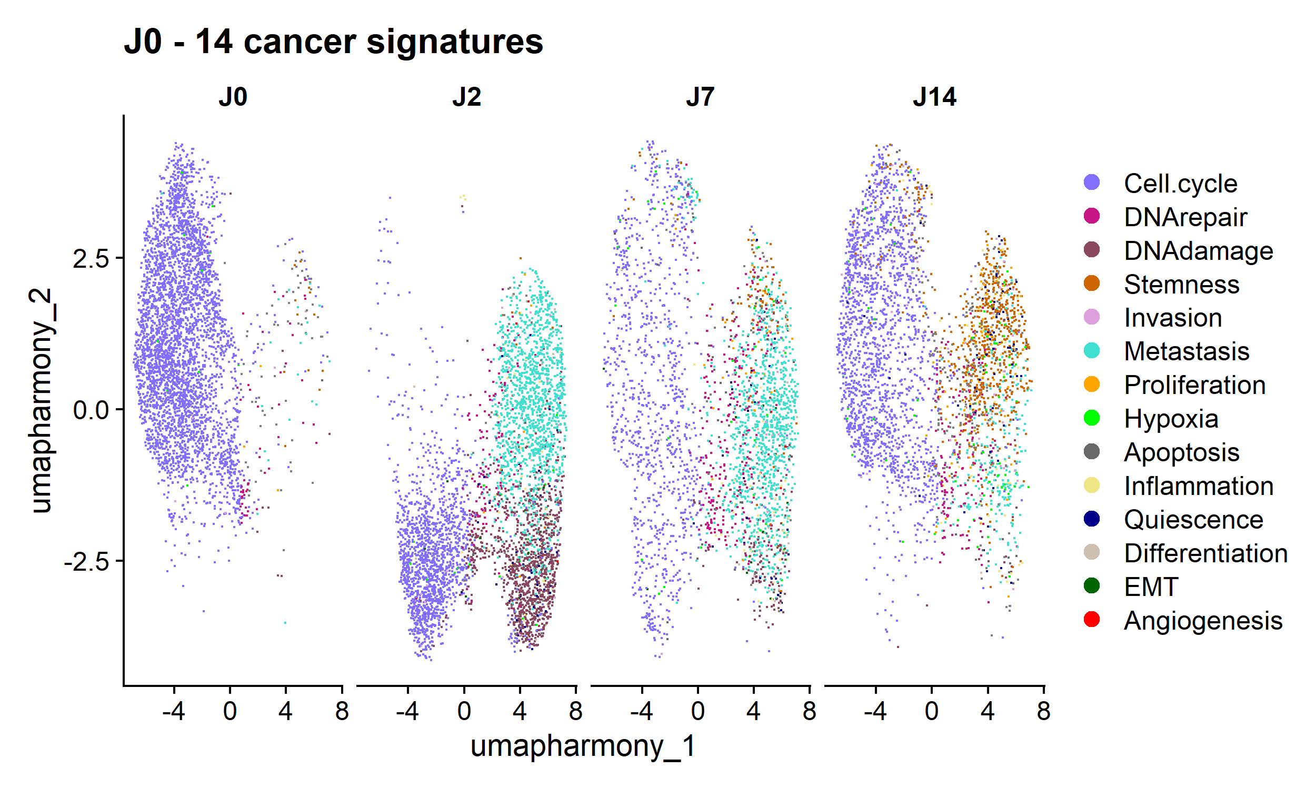
uoc.edu

Slide 28
uoc.edu

Slide 29
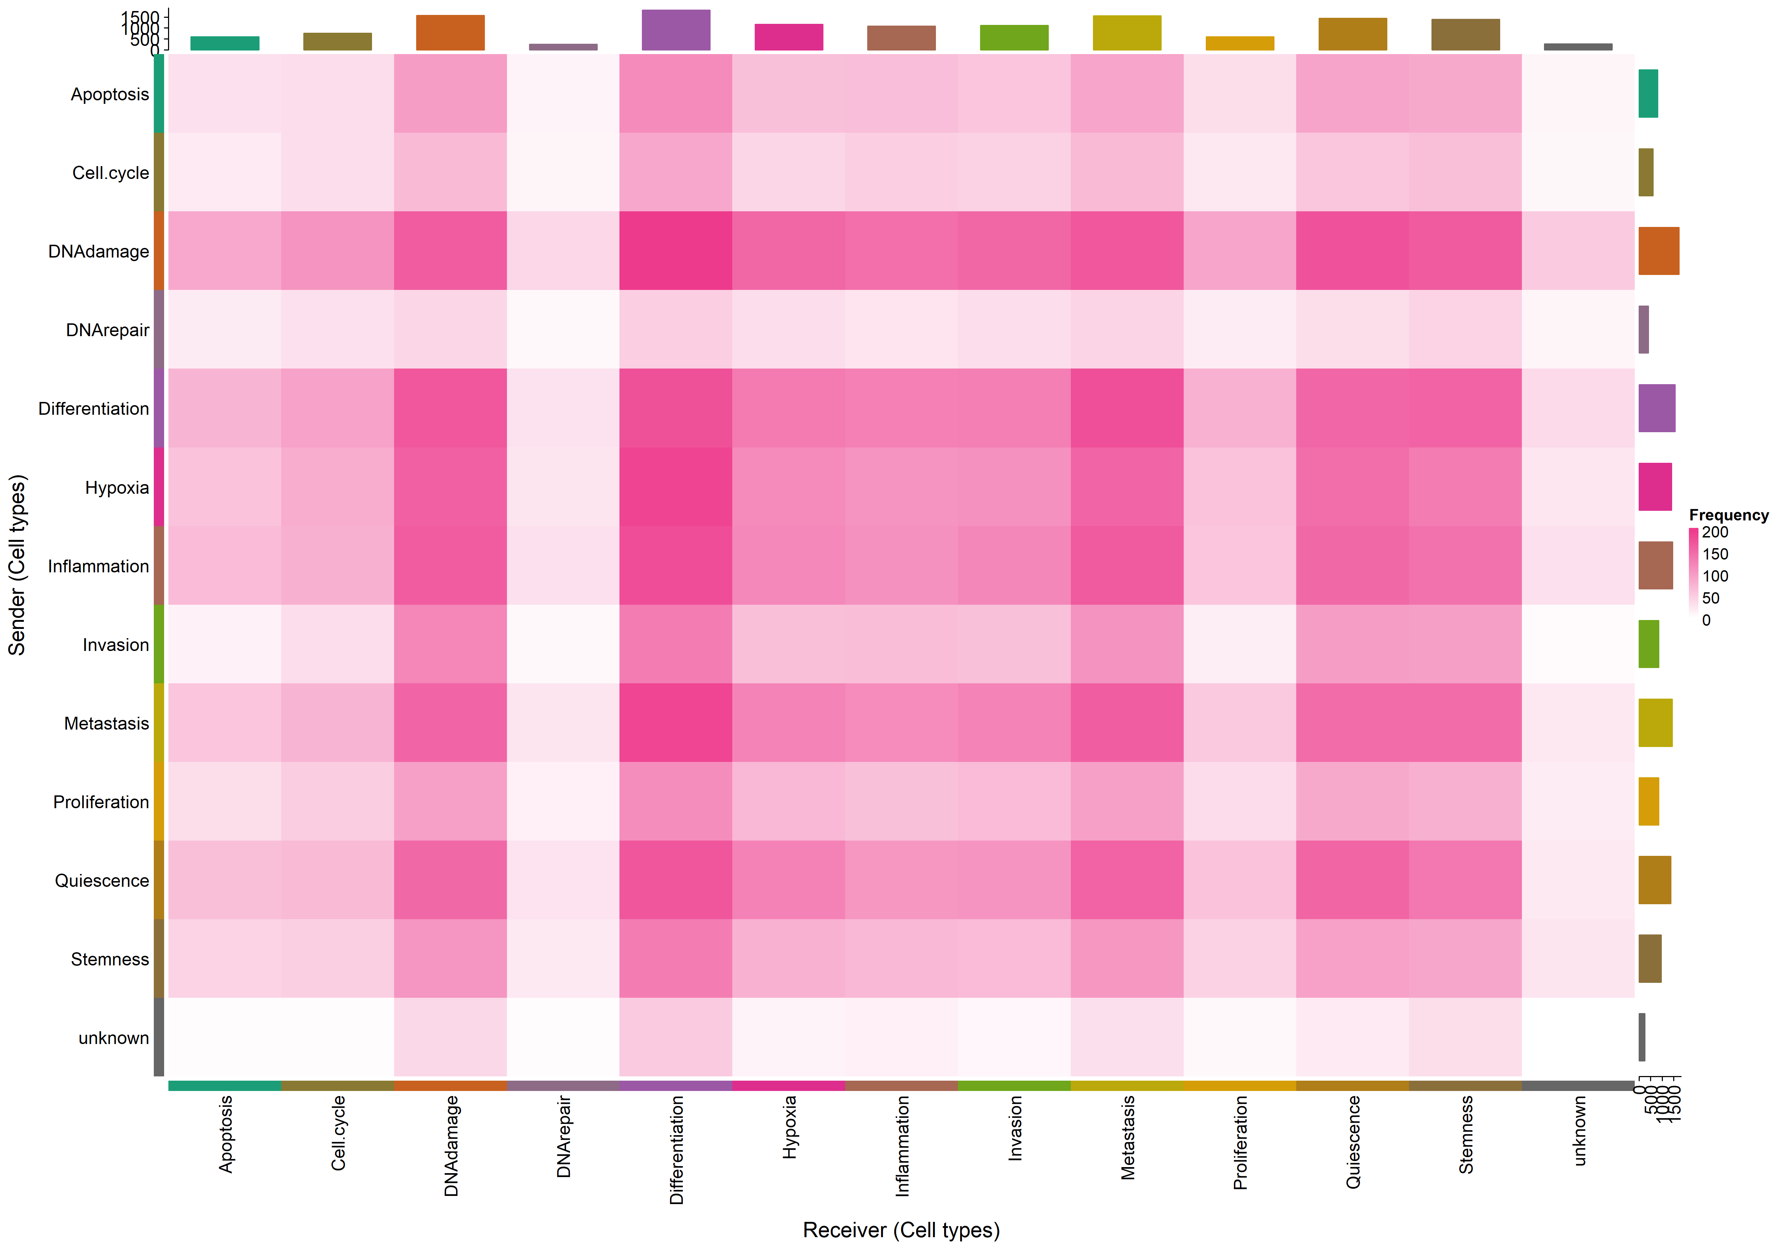
uoc.edu

Slide 30
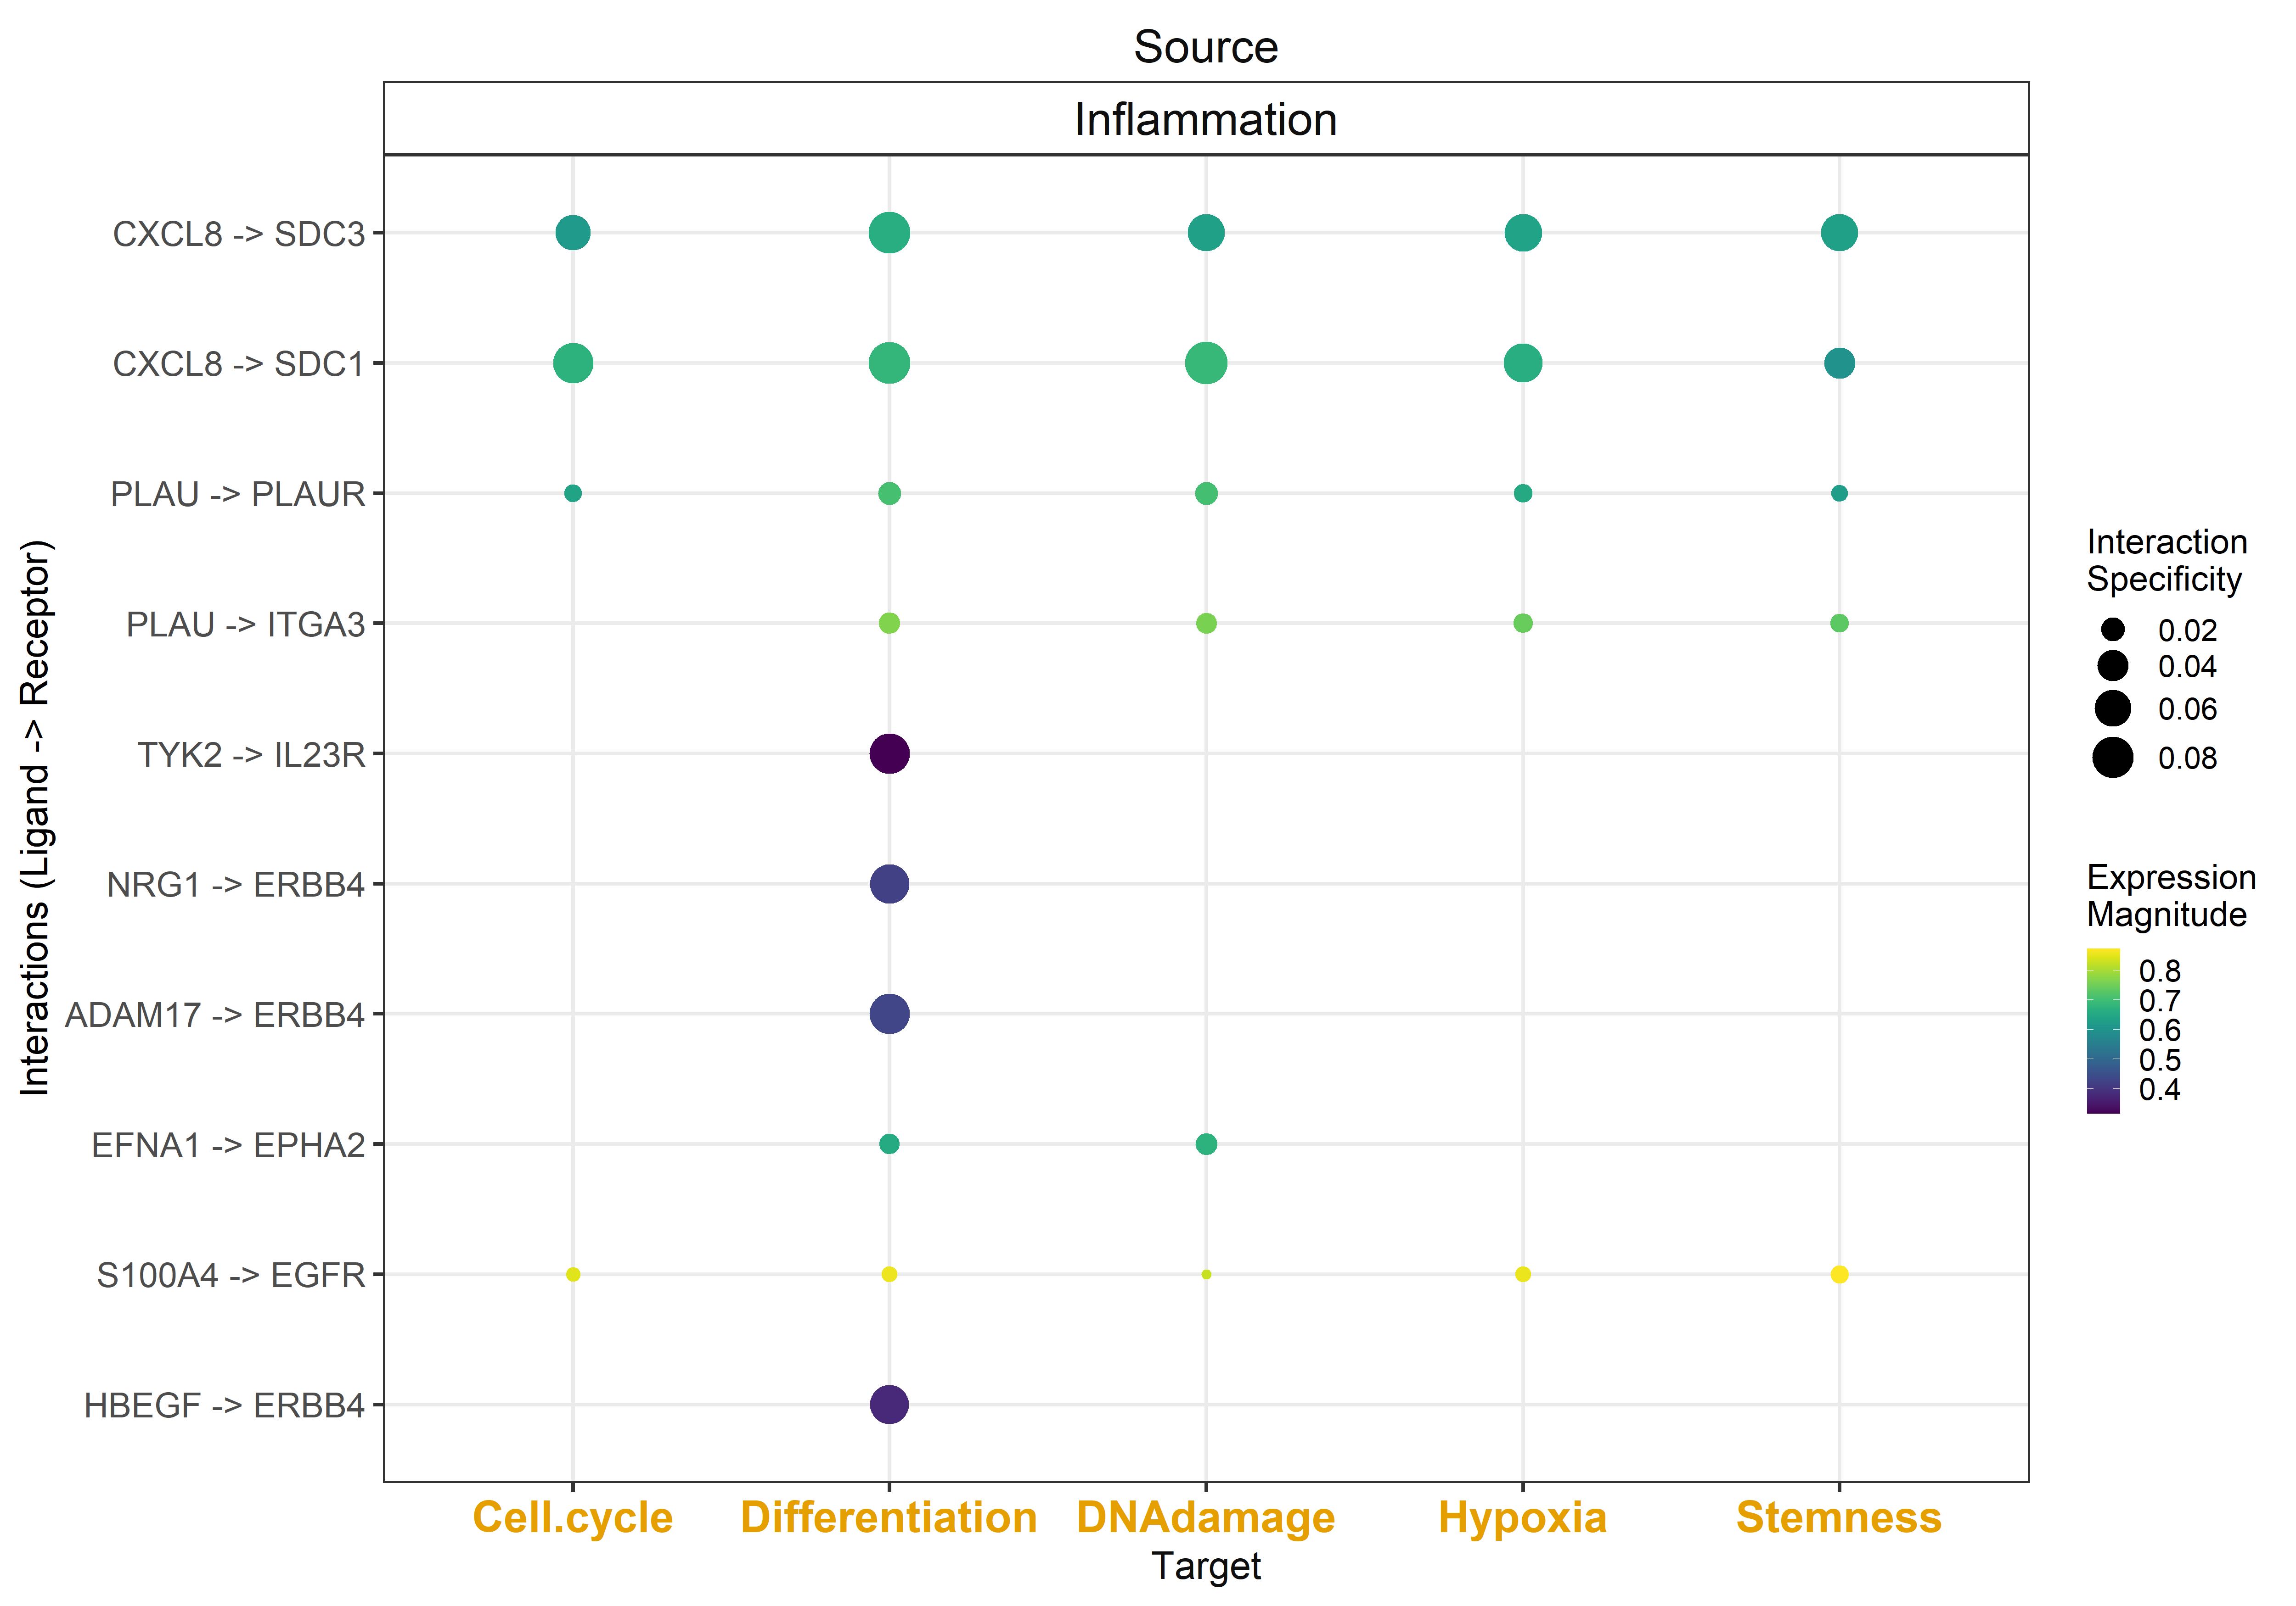
uoc.edu

Slide 31
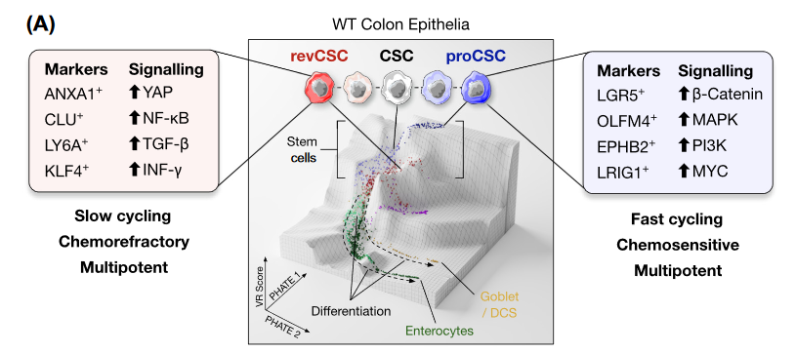
uoc.edu

Slide 32
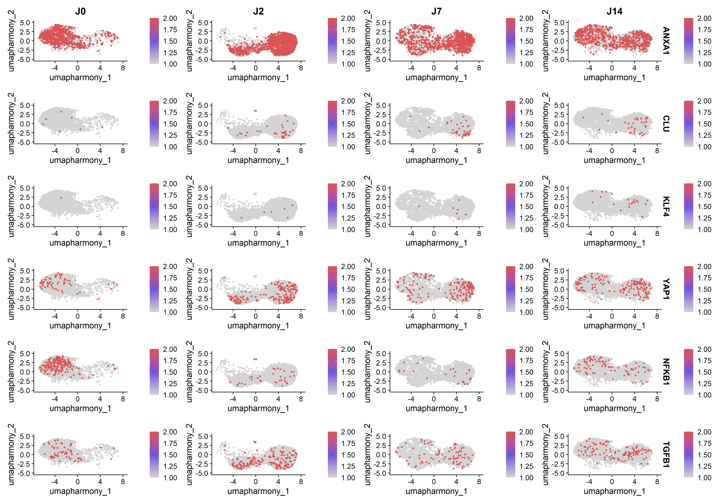
uoc.edu
Notes:
revCSC

Slide 33
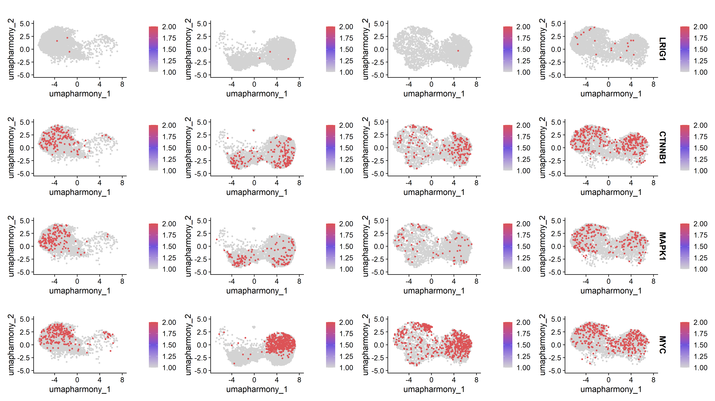
uoc.edu
Notes:
proCSC

